Slide 1
Joint Officer Management
J1
Notes:
On behalf of the Adjutant General of Texas, we are launching our Joint Officer Management Program also known as JOM.
If you are an officer interested in obtaining Joint Credit, then this short briefing is designed for you.

Slide 2
TEXAS MILITARY DEPARTMENT STRATEGY
VISION:
America’s premier state military comprised of mission-ready professionals fully engaged with our communities, and relevant through the 21st century.
MISSION:
Provide the Governor and President with ready forces in support of state and federal authorities at home and abroad.
PEOPLE FIRST – Invest in our human capital
Diverse & Engaged Force Sustained Through Effective Retention & Recruiting
Trained Ethical Professionals
Resilient Professionals & Families, Supported By Robust Services
Clearly Communicated Opportunities For Professional & Personal Development
RELEVANT & READY – Provide right force at the right time
Force Structure Optimized For Federal & State Missions
Modern Training Areas & Facilities That Support Our Mission
Effective Resource Management & Protection
Enhanced Joint, Interagency, Intergovernmental & Multinational Capabilities
COMMUNICATE & PARTNER – Deliver our message and build lasting relationships
Effective Communication Assets & Channels
Partnered & Informed Communities
Engaged & Educated Government Partners
Strong Department of Defense Relationships
J1
Notes:
The Texas military department’s vision is to be America’s premier state military comprised of mission ready professionals.
Joint Officer Management is exactly that, ensuring that our officers get the opportunities for professional development by enhancing their joint, interagency, intergovernmental and multinational capabilities. By achieving this, we would have developed strong Department of defense relationships through out officer’s careers.

Slide 3
What is Joint Officer Management (JOM)?
A program developed within the Texas Military Department to ensure officers are educated, trained and experienced in joint matters to enhance joint warfighting capability of the United States through awareness of joint requirements, including multi-service, interagency, international, and non-governmental perspectives.
Texas Military Department (TMD) J1 administers, develops and implements JOM for all officers from O-1 to O-6 level. Officers in the grades of O-7 and above are managed by the GOMO office.
References:
DoDI 1300.19, 2018
CJCSI 1330.05A
CNGBI 1704.01, 2016
NGB Joint Qualification Handbook, 2011
J1
Notes:
So what is Joint officer Management?
It’s a…. A program developed within the Texas Military Department to ensure officers are educated, trained and experienced in joint matters to enhance joint warfighting capability of the United States through awareness of joint requirements, including multi-service, interagency, international, and non-governmental perspectives
The TMD J1 is the lead for Joint officer management for the grades of O1-O6. We work closely with the General Officer Management Office (GOMO) when there is overlap on O6 officers.
You can view the references in the bottom right during this presentation and there will be one slide at the end with all consolidated references.

Slide 4
Why do we need to have Joint Qualified Officers (JQO)?
It’s the law! Reference Joint Matters defined in Title 10, USC § 668
In response to the Goldwater-Nichols Act of 1986, DoD Implemented the JOM program as the primary means to grow and develop officers well-versed in joint matters for the expressed purpose of supporting senior civilian leaders (including SECDEF and POTUS) and Unified Combatant Commanders, among other Joint Force Commanders
References:
DoDI 1300.19, 2018
CJCSI 1330.05A
CNGBI 1704.01, 2016
NGB Joint Qualification Handbook, 2011
J1
Notes:
Why do we need to have Joint Qualified Officers?
Bottom line, it’s the law.
DOD implemented the JOM program to grow and develop officers who are well versed in joint matters for the purpose of supporting senior civilian leaders such as SEC DEF and POTUS. Officers also serve under a unified combatant commander or a joint force headquarters and understating Joint Matters is key to being successful in those types of assignments.
As you can see, this program has been around for quite some time, but we are now focusing more on National Guard Officers to become Joint qualified.

Slide 5
How does this impact TMD Officers?
Effective 01 October 2020, only officers with significant joint experience (as identified in the Joint Matters definition), will be nominated or appointed to National Guard General Officer T10 Assignments.
What is significant Joint Experience?
At a minimum, completion of Joint Professional Military Education Level II or Advanced Joint Professional Military Education and no less than 50% of the joint points required to achieve joint qualification level III.
Reference:
CJCSI 1330.05A, 2015
CNGBI 1704.01, 2016
J1
Notes:
As an officer, you may have heard this mentioned to you before. Per CNGBI 1704.1 Effective 01 October 2020, only officers with significant joint experience (as identified in the Joint Matters definition), will be nominated or appointed to National Guard General Officer T10 Assignments. Being Joint Qualified also opens the doors to other broadening assignments and opportunities for officer career enhancement.
What exactly is significant Joint Experience? At a minimum, completion of Joint Professional Military Education Level (JPME) II or Advanced Joint Professional Military Education and no less than 50% of the joint points required to achieve joint qualification level III. Makes sense right?
In other words: Significant Joint experience equals 18 joint credit points plus JPME level 2.
We will discuss more about obtaining JPME later in the presentation.

Slide 6
How to become a Joint Qualified Officer (JQO)?
J1
Notes:
Now that you understand the joint matters definition, what do you need to become a Joint Qualified Officer?
The first thing you need to know is that it takes time. If everything works like the “text book” process it can take about 3 years. But don’t let that be discouraging.
I’m going to keep it simple, all you need to be a JQO is to have Joint Experience and Joint Education.
The next slides will break this down further.

Slide 7
How do you obtain Joint Experience? (1 of 2)
Serving in a Standard Joint Duty Assignment List (S-JDAL) meaning: an officer (O4 and above) who completes a two (2) year assignment in a full-time Joint Duty Assignment List (JDAL) position or four (4) years in a part-time JDAL position DSG/M-Day (36 day per year requirement)*
J3
J7
Austin
Reference:
DoDI 1300.19, 2018
J1
Notes:
I will first discuss how to obtain joint experience.
And How do YOU obtain joint experience?
An officer can obtain joint experience by Serving in a Standard Joint Duty Assignment List (S-JDAL) meaning: an officer (O-4 & above) who completes a two (2) year assignment in a full-time Joint Duty Assignment List (JDAL) position or three (3) years in a part-time JDAL position DSG/M-Day (36 day per year requirement)*
Currently, here are a total of 18 approved JDAL positions within NGB and various states and territories. As of November 2017, we have two of these positions in TEXAS!
The J3 and the J7 are now approved JDAL positions. Individuals serving in those positions will obtain automatic joint credit for serving in a JDAL. This means those individuals will not have to self-nominate for joint credit.
Other opportunities where individuals may serve in JDAL assignments are while Deployed or serving at one of the Combatant Commands as well as NGB title 10
What happens if you served in a JDAL assignment but did not meet the full 2 or 3 year requirement? Partial credit is given to the officer who served in that JDAL assignment, but to be JQO, you must have all of the required time or points.

Slide 8
How do you obtain Joint Experience? (2 of 2)
Serving in a Experience - Joint Duty Assignment (E-JDA) allows officers O-1 and above to accumulate joint experience points by completing shorter joint assignments, exercises, or training.
Officers who serve in E-JDA assignments must SELF-NOMINATE to obtain joint credit. Each self-nomination must meet the joint matters definition (next slide).
Each Experience submission must cover 30 or more duty days.
Officers must submit their self-nomination within 12 months of experience completion.
Supporting documentation for the Self-Nomination include but are not limited to OERs/OPRs/ Tech Appraisals/ Awards, Assignment orders, etc.
Self Nomination Website: https://jqs.dmdc.osd.mil/appj/jqs
Reference:
DoDI 1300.19, 2018
NGB Joint Qualification Handbook
J1
Notes:
Because JDAL Positions are limited, there are other options to obtain joint Experience:
By Serving in a Experience - Joint Duty Assignment (E-JDA) allows officers O-1 and above to accumulate joint experience points by completing shorter joint assignments, exercises, or training
Please not that:
Each Experience submission must cover 30 or more duty days
Officers must self-nominate to obtain joint credit
The Self nomination must be done within 12 months of experience completion
Along with the Self nomination, officers must provide OERs/ OPRs/ Tech Appraisals/ Awards, Assignment orders etc.
The individual officer is the only one who can submit the self nomination to the website. Make sure you have a cac enabled computer to log in and in the first screen select eligibility criteria instead of National Guard.
You can find more details on self nomination by reviewing the Joint Qualification handbook and the references listed at the end of the presentation.

Slide 9
What are Joint Matters?
What you did…
Who you did it with…
J1
Notes:
What are Joint Matters?
Joint Matters are matters related to the achievement of unified action by integrated military forces in operations conducted across domains such as land, sea, or air, in space, or in the information environment.
It’s all about What you Did and who you did it with.
There are three distinct parts of the definition – the “what” the “who,” and the “unified action.” In order to satisfy the definition, one element of the “who” and “what” must be fulfilled in a way that a unified action is achieved.
What you did - must include any of the following, National military strategy, strategic planning and contingency planning, command and control of operations under unified command, national security planning with other departments and agencies of the united states or combined operations with military forces of allied nations.
Who you did it with refers to military forces involving more than one military department or a military department and one or more of the following, other departments and agencies of the united states, the military forces or agencies of other countries or non-governmental persons or entities.
The “unified action” is a synergistic application of all the instruments of national and multinational power and includes the actions of non-military organizations as well as military forces.
Examples are Operation ENDURING FREEDOM, Operation IRAQI FREEDOM, Operation NOBEL EAGLE.
An officer needs to be specific in explaining the relationship of the job versus joint tasks and responsibilities in achieving the definition of joint matters. The member’s duties and actions must contribute to the achievement of unified action by integrated forces consisting of armed forces, departments or agencies from one or more Services or countries. So then, not all of the categories may apply to the officer’s experience.

Slide 10
What is the process for Self Nomination?
Officer completes an assignment with joint experience
Officer submits Self-Nomination (word document) to their COMPONENT (ARNG or ANG) within 12 months
COMPONENT Submits the Self-Nomination (word document) to J1 for Review
J1 returns the Self- Nomination (word document) through COMPONENT to the Officer (for Re-work or submission)
Officer Submits the Self-Nomination into the JQS Self-nomination website with substantiating documents
J1 will track each nomination throughout the boarding process
If approved: Officer receives joint credit memo from NGB
If disapproved: Officer receives notification from J1
J1 notifies the COMPONENT of the SM to update their Official Military Record respectively
Start
Component = TXARNG or TXANG
End
Joint Qualification System (JQS) Self-Nomination Link: https://jqs.dmdc.osd.mil/appj/jqs
J1

Slide 11
How are Joint Points Calculated in the Board?
Reference:
DoDI 1300.19, 2018
J1
Notes:
Its important that you understand how the Joint Points are calculated during a self nomination board.
Joint Experience points are calculated based on Months times the intensity factor. Either 2 points for combat or 1 point for non-combat
Discretionary points equal to Education plus training plus exercises
For Education and training the attendee obtains a degree or certificate related to joint matters showing the amount of points that course or training was worth.
If service members participate in a joint exercise they obtain 1 point (regardless if they were a key participant/ planner or leader)
Overall: Joint Qualification Level equals to Experience points plus discretionary points plus Joint Education or JPME.

Slide 12
What if you missed the Self Nomination 12 month window?
It’s not too late!
NGB is working on re-opening the window in the near future, but before it’s opened, we need the following:
- Educate the field of the importance of Joint Officer Management
- Ensure Officers understand the Joint Matters Definition when working on their Self-Nomination submissions
- Assist those officers who missed the window by reviewing their pre-templated Self-Nominations and have them ready to submit when the window opens.
J1
Notes:
So what happens if you missed the 12 month window?
It’s important to know that it’s not too late
In the last 10 years, NGB opened the window 3 times for retroactive credit; unfortunately, the knowledge of the program was not sufficient to reach everyone and many lost the opportunity to submit their self-nominations. Now, NGB JOM is recommending to re-open the window again, but they want to maximize the submissions, therefore, we need to ensure the following:
Educate our officers about Joint Officer Management
Ensure our officers understand the Joint Matters Definition when working their Self Nominations.
Assist those officers who missed the window by reviewing their pre-templated Self Nominations so when the window opens, they can just copy and paste to submit.
Once the retroactive window opens, TMD will ensure to maximize the advertisement for all officers to be informed.

Slide 13
Joint Opportunities within TMD
Para/line Duty Title Grade Branch/AFSC MOS
31+4 (31 Officer positions and 4 General Officer Positions)
Key Developmental Assignments
Self-Nominate for serving in these positions
(JDAL)
(JDAL)
J1
Notes:
Now that we’ve mentioned Joint Experience, here are some positions within TMD where the incumbents can obtain joint credit.
This *NEW* TDA structure within Joint Force Headquarters includes Joint assignments within TMD is under UIC 93PAA also known as 31+4
Army or Air Guard officers are boarded to these Key Developmental Assignments for career progression
Individuals who serve in any of these positions can self-nominate at the end of their tour for joint experience credit
These positions are available for AGR/TECH or Mday personnel depending on the need of the organization and personnel available
We recommend that Leaders and mentors nominate individuals to serve in these positions and mention it to senior leadership

Slide 14
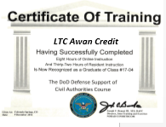
Other Opportunities for joint credit within TMD
6 Points is the maximum for discretionary credit
Discretionary joint credit may be derived from joint experience, joint training, joint exercises and other education…
Joint Exercises: Vigilant Guards, RED FLAG, Saber Guardian etc. (See Approved Joint Exercises List posted on our JOM Public site)
Joint credit validation for exercises is via discretionary credit memorandum signed by the first O6 in the chain of command and emailed to the TMD JOM office: ng.tx.txarng.mbx.jom@mail.mil
Officers who complete Joint Training Courses: Send a copy of your training certificate to ng.tx.txarng.mbx.jom@mail.mil to update the joint database.
Reference:
DoDI 1300.19, 2018
J1
Notes:
Here are other opportunities for Joint Credit within TMD.
Discretionary credit may be derived from joint experience, joint training, joint exercises and other education…
Examples of Exercises within TMD are Vigilant Guards, RED FLAG, Saber Guardian etc. We invite you to visit our JOM Public Website to view all of the approved Joint Exercises List posted. You will find the link to our website at the end of the presentation.
Exercises are currently calculated as follows. If you served in a leadership position such as (commander, XO) you would be entitled for 3 points for that event. If you were a planner (S3 for example) you would obtain 2 points. If you are exclusively a participant you would earn 1 point.
Units who participate in these joint exercises can submit a memorandum to J1 for discretionary joint points. A memorandum is submitted to the Joint Officer Management Office with a by name roster and each individual’s role (ie. Leader, Planner, Participant) signed by the first O6 in the chain of command. Once credit is awarded, the unit will be notified.
Joint Training and education: The TMD J7 produces a list of Joint Courses where you can obtain joint credit. Visit our website or follow the link to See TAB D (Joint Professional Military Education (JPME) Training Opportunities) Once the training is completed, the certificate must be uploaded into iPERMED or PRDA and forwarded to the Joint Officer Management Office distro list.
Lastly, please keep in mind that 12 points is the maximum for discretionary credit. Any additional joint courses or exercises will not count towards your joint qualification.

Slide 15
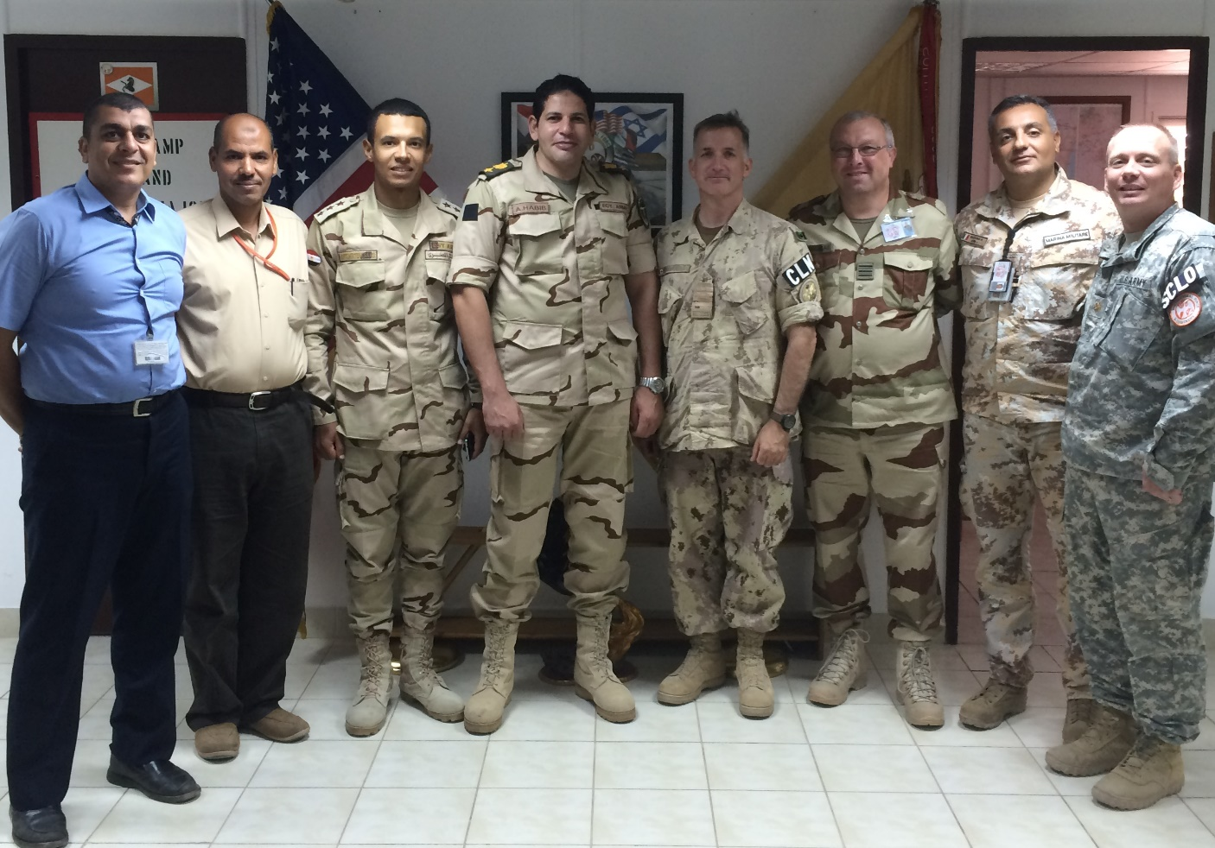
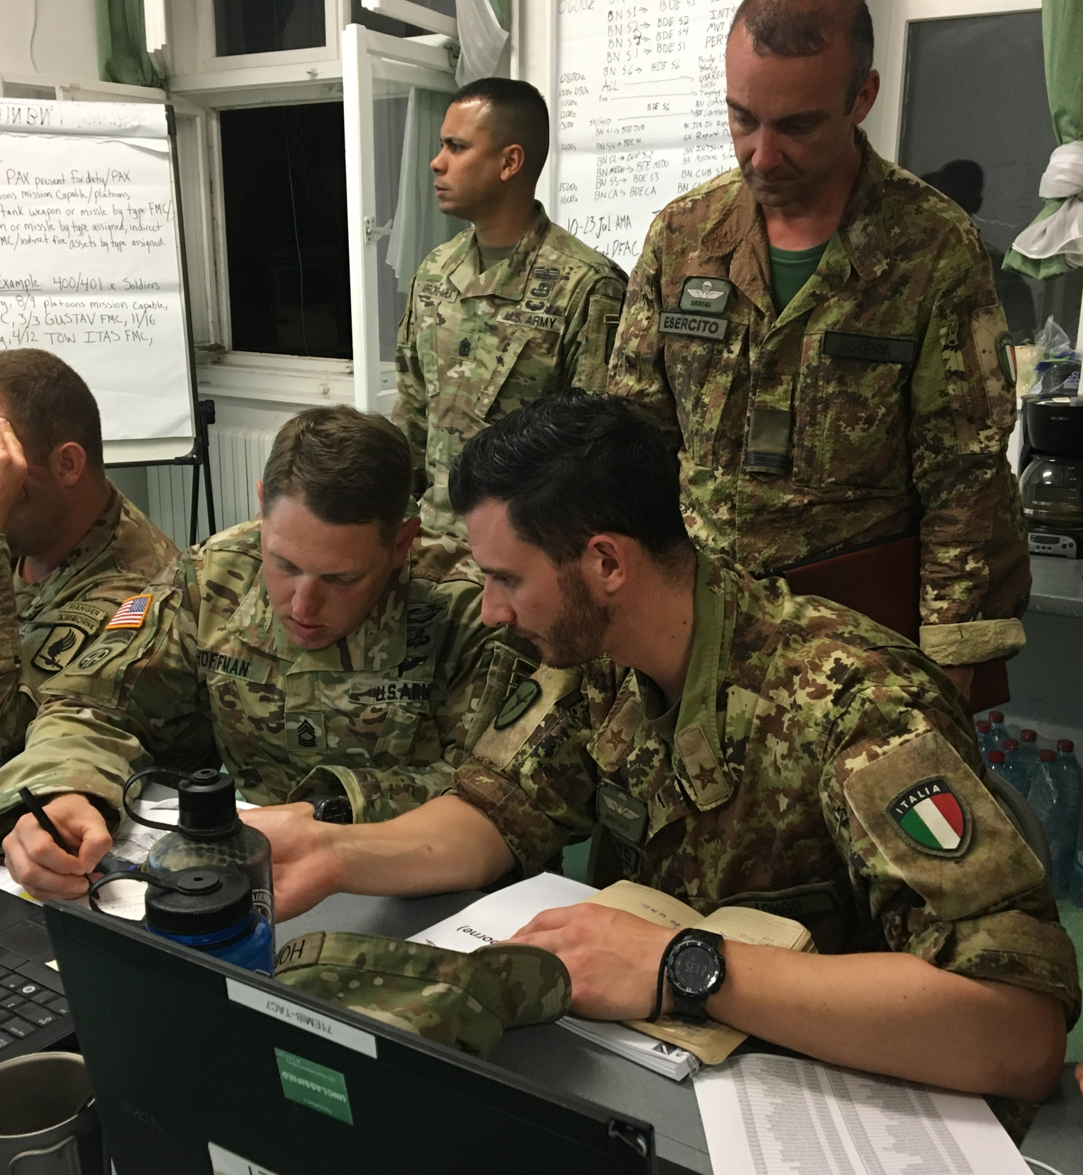
Examples of TMD Joint Experiences
Deployment: Multinational Force and Observers Mission, 2015
JOINT MATTERS!
Exercise: Saber Guardian, 2017
Exercise: TX-CERFP at LA Vigilant Guard, 2016
J1
Notes:
Here are some examples of Joint Experiences that have awarded joint credit to our TMD officers..
The Cav unit participated in the Multinational Force and Observers Mission, in 2015
Our TX-CERFP and Homeland Response Force participated in Vigilant Guards
And just recently, the 143rd Infantry participated in Saber Guardian 2017 with multinational forces as well.

Slide 16
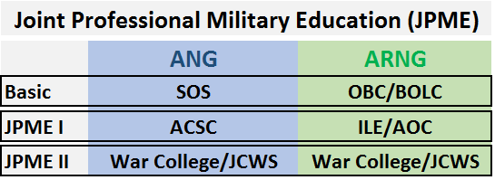
What is Joint Professional Education?
NOTE: iPERMS or PRDA do not automatically update officer’s Joint Officer History (JOH); therefore, training certificates (1059, AF IMT 475) for JPME courses must be sent to the JOM group email for processing.
JOM: ng.tx.txarng.mbx.jom@mail.mil
Reference:
CJCSI 1800.01E, Officer Professional Military Education Policy (Appendix C to Encl A), 2015
J1

Slide 17
Levels of Joint Qualification
LEVEL II
Accrue 12 joint qualification points
Complete JPME Level I
NOTE:
Minimum of 6 of the 12 points must be derived from joint duty or experiences other than joint training or joint exercises)
- Maximum of 6 discretionary points derived from joint training, joint exercises, and education
Significant Joint Experience is:
Minimum of 12 Joint Credit points
Completion of JPME II
LEVEL III (JQO)
Accrue 24 joint qualification points by Completing a Joint Duty Assignment via
Standard (S-JDA)
Experience-based (E-JDA)
Complete JPME Level I and II
NOTE:
Minimum of 18 Points must be derived from joint duty or experiences
Maximum of 6 discretionary points from Joint Training, Joint Exercises and other education
Out of those 24 points, a minimum of 12 points must come from joint experience earned in the pay grade of O-4 or higher.
Notes:
Now that we’ve covered Joint Experience and joint education, I’m going to explain the two important levels of Joint Qualification.
Level II:
Awarded upon accrual of 12 points and completion of JPME Level I
- A minimum of 6 points must come from joint duty or experience.
- A maximum of 6 discretionary points may be derived from joint training,
joint exercises, and education/training courses other than JPME.
Level III:
Awarded upon accrual of a minimum of 24 total points (based on Level II point requirements, normally 12 more points
since Level II) and completion of JPME Phase II and
Note:
A minimum of 18 points must come from joint duty or experience.
A maximum of 6 discretionary points may be derived from joint training, joint exercises, and education/training courses other than JPME.
Recency requirement: a minimum of 12 months in a position, either aggregated or served all at once, must come from joint experience earned
in the pay grade of O-4 or higher. Officers must be an O-4 (for pay purposes) for at least 1 day while filling an S-JDA.
For the 2020 General Officer rule, Significant Joint experience equals to a minimum of 12 joint credit points and completion of JPME II.

Slide 18
Path to become JQO Level III
Full Accrued Credit
JOINT QUALIFIED OFFICER (JQO)
A
Joint Duty Assignment List (JDAL) 24 Months (4 Years for MDAY/DSG)
(Combination)
Partial Accrued Credit + Joint Experience $≥$ 24 points
Discretionary Points (up to 6 Pts)
6 Months Joint Experience
(Self-Nomination)
B
12 Months JDAL
Discretionary Points (Up to 6 Pts)
18 Months Joint Experience (Self – Nomination)
(Must have a minimum of 12 points as O-4 and above)
$≥$ 24 Experience Points
C
Joint Experience (Self – Nomination)
(Must have a minimum of 12 points as O-4 and above)
$≥$ 24 Experience Points
D
Levels of Joint Professional Military Education (JPME )
JPME Level I
ILE&AOC(ARNG) – IDE/ACSC(ANG)
JPME Level II War College Resident or JCWS
OBC/BOLC (ARNG)
PDE/SOS (ANG)
J1
Notes:
We have reviewed Joint Experience, Joint Education and the levels of Joint Qualification. Now I will show you the Path To Joint Qualification.
As mentioned before, all you need to become JQO is to complete your Joint Experience and Joint Education. Because not all officers and careers are created equal, we developed chart to explain the different variations that officer may take to become JQO.
As discussed previously. JDAL assignments are very limited, but if an officer serves in a JDAL assignment full time for 24 Months, they will obtain full Accrued credit and be classified a JQO. This is depicted in Officer A.
Now Officer B shows a different case. Serving only 1 Year in a JDAL assignment (full time), they also maximized their discretionary points so all they needed left was to self-nominate for Joint Experience completed to reach the 24 or more points. We call this a “combination”. This type of case is more common.
Then Officer C Maximizes their Discretionary Points, then Self Nominates for their joint experience to obtain 24 or more joint credit points.
We read before that it only takes 12 points to be JQO level II, then 24 points to be JQO level III. In some cases we have officers that have 50 or 60 points. And that’s ok, we just have to make sure that the officer met all the guidelines and they can be JQO once they complete their JPME II.
Lastly, We still need the Joint Professional Military education (JPME)
The officer education is straight forward, JPME I the officer needs OBC/SOS and ILE with AOC complete/ACSC then have either War College Resident or Joint Combined Warfighting School (JCWS) (which is a 10 week resident or 40 week DL).
Again, path to JQO is Joint Experience PLUS joint Education equals: JQO.

Slide 19
Where do you start?
Review your Joint Officer History (JOH) by going to the Joint Qualification System Website: https://jqs.dmdc.osd.mil/appj/jqs (Note: Once you login SELECT the ELIGIBILITY CRITERIA link near the bottom).
Express your interest for Joint Opportunities (ie: Joint KDA Assignments (31+4), JDAL assignments, Exercises, Deployments and Joint training.)
Ensure that your participation for any Exercises, and joint training is documented (Certificates / Orders/ Awards) in your system of record (iPERMS/MILPDS)
Self-Nominate when serving in Joint Assignments / State Side and/or from a Deployment
Ensure your ILE/AOC and ACSC are included in your JMIS record to show JPME Level I complete.
Look for opportunities to complete JPME Level II and provide supporting documentation to your system of record (iPERMS/MILPDS)
J1
Notes:
Fist, we encourage each of you to review your joint officer history by going to the JQS website. Review your record and see if you have any missing information for any joint assignments or JPME.
Look for joint opportunities (joint KDA Assignments, JDAL assignments within TMD or T10, Exercises, Deployments and attend joint training.

Slide 20
References:
DoDI 1300.19 Joint Officer Management Program Procedures, 2018
CJCSI 1330.05A Joint Officer Management Program Procedures, 2015
CJCSI 1800.01E, Officer Professional Military Education Policy (Appendix C to Encl A)
CJCSI 3500.01H, Joint Training Policy and Guidance for the Armed Forces of the United States
CNGBI 1704.01 National Guard Joint Officer Management Program, 2016
AFI 36-2135 Joint officer Management
NGB Joint Qualification Handbook, 2011
J1
Notes:
Here are the references mentioned in the briefing and some additional references for your benefit.
You may have noticed some of the information has changed as far as the point system for JOM, and that is due to the new DODI updated as if April 2018.

Slide 21
Visit our website: https://tmd.texas.gov/jom
or
Contact us with your questions!
ng.tx.txarng.mbx.jom@mail.mil
JOINT MATTERS!
J1
Notes:
Thank you for listening to this presentation, If you have questions or want to learn more please visit our website. You can also send us an email with your questions.

