Slide 1
Workers' Compensation Basics
for State Employees
TEXAS MILITARY DEPARTMENT
Notes:
Slide Intent:
Introduce yourself
Introduce the course
Suggested Approach:
Additional Information:

Slide 2
TEXAS MILITARY DEPARTMENT STRATEGY
VISION:
America’s premier state military comprised of mission-ready professionals fully engaged with our communities, and relevant through the 21st century.
MISSION:
Provide the Governor and President with ready forces in support of state and federal authorities at home and abroad.
PEOPLE FIRST – Invest in our human capital
Diverse & Engaged Force Sustained Through Effective Retention & Recruiting
Trained Ethical Professionals
Resilient Professionals & Families, Supported By Robust Services
Clearly Communicated Opportunities For Professional & Personal Development
RELEVANT & READY – Provide right force at the right time
Force Structure Optimized For Federal & State Missions
Modern Training Areas & Facilities That Support Our Mission
Effective Resource Management & Protection
Enhanced Joint, Interagency, Intergovernmental & Multinational Capabilities
COMMUNICATE & PARTNER – Deliver our message and build lasting relationships
Effective Communication Assets & Channels
Partnered & Informed Communities
Engaged & Educated Government Partners
Strong Department of Defense Relationships
TEXAS MILITARY DEPARTMENT
Notes:
Slide Intent:
Remind participants about TMD’s Mission and Vision
Suggested Approach:
Challenge the audience to consider how WC fits in with our Mission as you go through these slides.
Additional Information:

Slide 3
Basic Information
TEXAS MILITARY DEPARTMENT
Notes:
Slide Intent:
Suggested Approach:
Additional Information:

Slide 4
Should I Submit a Claim or Report an Incident?
Submit a Claim if… | Report an Incident if…
You are a State employee or on State Active Duty orders You had an injury or exposure to an illness that happened on duty You had medical treatment at a doctor’s office, urgent care clinic, occupational medicine clinic, or ER You are unable to work your regular job as a result of this injury/illness | You are a State employee or on State Active Duty orders You had an injury or exposure to an illness while on duty (may become a claim later)
Clarification: An employer shall keep a record of all incidents and injuries
Sec. 409.006. RECORD OF INJURIES; ADMINISTRATIVE VIOLATION.
TEXAS MILITARY DEPARTMENT
Notes:
Slide Intent:
Provide reference material for presentation
Suggested Approach:
Give a quick once over to let the audience know that TX workers’ compensation is guided by actual State law.
Additional Information:

Slide 5
Process
TEXAS MILITARY DEPARTMENT
Notes:
Slide Intent:
Suggested Approach:
Additional Information:

Slide 6
TMD State Workers’ Compensation Process
NOT an Emergency
Forms to TMD Workers’ Comp Coordinator
Use SORM billing information for medical treatment in the CareWorks network
Injury/Illness
Forms Completion
MEDICAL EMERGENCY, HOSPITALIZATION, DEATH
Medical Emergency
Hospitalization
Death
Notify TMD Workers’ Comp Coordinator ASAP
but NLT 24 hrs
Forms to TMD Workers’ Comp Coordinator
EMERGENCY TREATMENT
FORMS
Completion
NOTE: Don’t forget to notify your Chain of Command/Supervisor ASAP
TEXAS MILITARY DEPARTMENT
Notes:
Slide Intent:
Suggested Approach:
Additional Information:

Slide 7
Remember…
Delays in reporting may result in a denied claim or delay of benefits for the injured person
TEXAS MILITARY DEPARTMENT
Notes:
Slide Intent:
Suggested Approach:
Additional Information:
Read the slide, please

Slide 8
What’s Your Role
TEXAS MILITARY DEPARTMENT
Notes:
Slide Intent:
Suggested Approach:
Additional Information:

Slide 9
Injured Person
Supervisor
Notify Supervisor of incident/injury
Complete and submit ALL required forms within 3 - 5 days of the incident/injury
Seek medical treatment in the CareWorks network, if needed
Inform the doctor this is a work-related incident/injury and provide SORM billing information
Report ALL work status changes (going off mission and/or unable to perform all essential mission duties) immediately
Keep all follow-up appointments
Maintain regular contact with supervisor
Notify the TMD State Workers’ Compensation Coordinator (WCC) within 24 hours of incident/injury
IMMEDIATELY notify TMD WCC of hospitalization or death
Assist the injured person with obtaining forms, if needed
Report ALL work status changes to WCC (going off mission and/or unable to perform all essential mission duties)
Notify WCC of any issues or concerns
Maintain contact with injured person for status
Assist the injured person with return to work
TEXAS MILITARY DEPARTMENT
Notes:
Slide Intent:
Suggested Approach:
Additional Information:
Read the slide, please

Slide 10
Forms Guidance
TEXAS MILITARY DEPARTMENT
Notes:
Slide Intent:
Suggested Approach:
Additional Information:

Slide 11
Injured Person
SORM 29 – Employee’s Report of Injury
SORM 16 – Authorization for Release of Information
SORM 80 – Leave Election Form (State employee only)
Network Acknowledgement Form
Don’t forget a copy of the orders (SAD only)
Required Forms
Supervisor
SORM 703 – Investigation Form
DWC1s – Employer’s Report of Injury
NOTE: Forms should be emailed to the Workers’ Compensation Coordinator (WCC) as soon as possible to avoid delays with treatment or possible denial of the claim.
Witness
SORM 74 – Witness Form
TEXAS MILITARY DEPARTMENT
Notes:
Slide Intent:
Stress the required forms by the appropriate person
Suggested Approach:
Additional Information:
Please use these words – “It is inappropriate for an injured person to complete supervisor forms and may be considered an act to influence the claim decision”

Slide 12
Training Examples Injured Person NOTE: These are only examples of how to complete the forms.
TEXAS MILITARY DEPARTMENT
Notes:
Slide Intent:
Suggested Approach:
Additional Information:

Slide 13
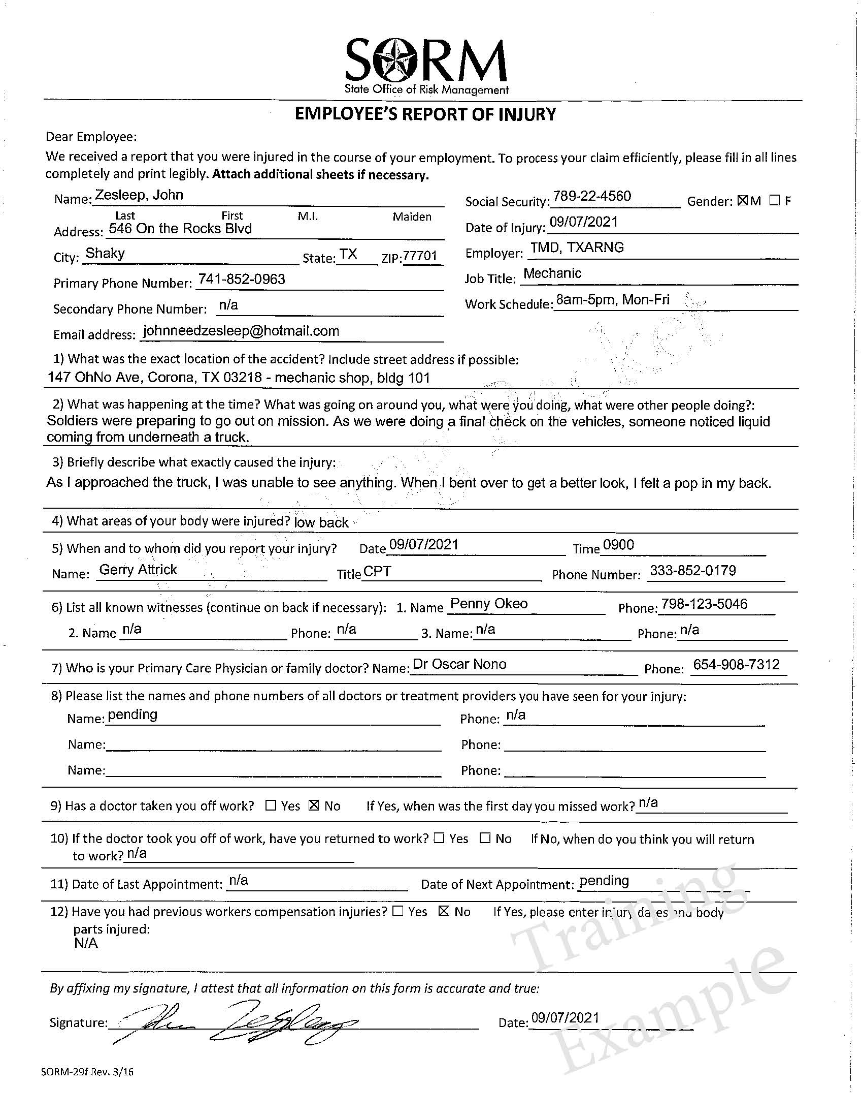
Question 1
Physical address AND exact location
Question 5
Who in your chain did you report this to and when?
Question 2
What were you doing? Where were you going?
Question 6
Who seen it, heard it, or was told about it?
Question 3
What motion or action caused your injury?
Question 8
Who provided medical treatment?
Question 4
EXACT body parts
Example
Right knee
Left elbow
Question 9
Did the doctor tell you not to work?
TEXAS MILITARY DEPARTMENT
Notes:
Slide Intent:
Training example
Suggested Approach:
Additional Information:
Stress the importance of completing this form in the recommended manner. The training example is meant to highlight an opportunity for achieving an accepted claim but should not be copied directly. Words matter – be appropriate but don’t indulge to make a point.

Slide 14
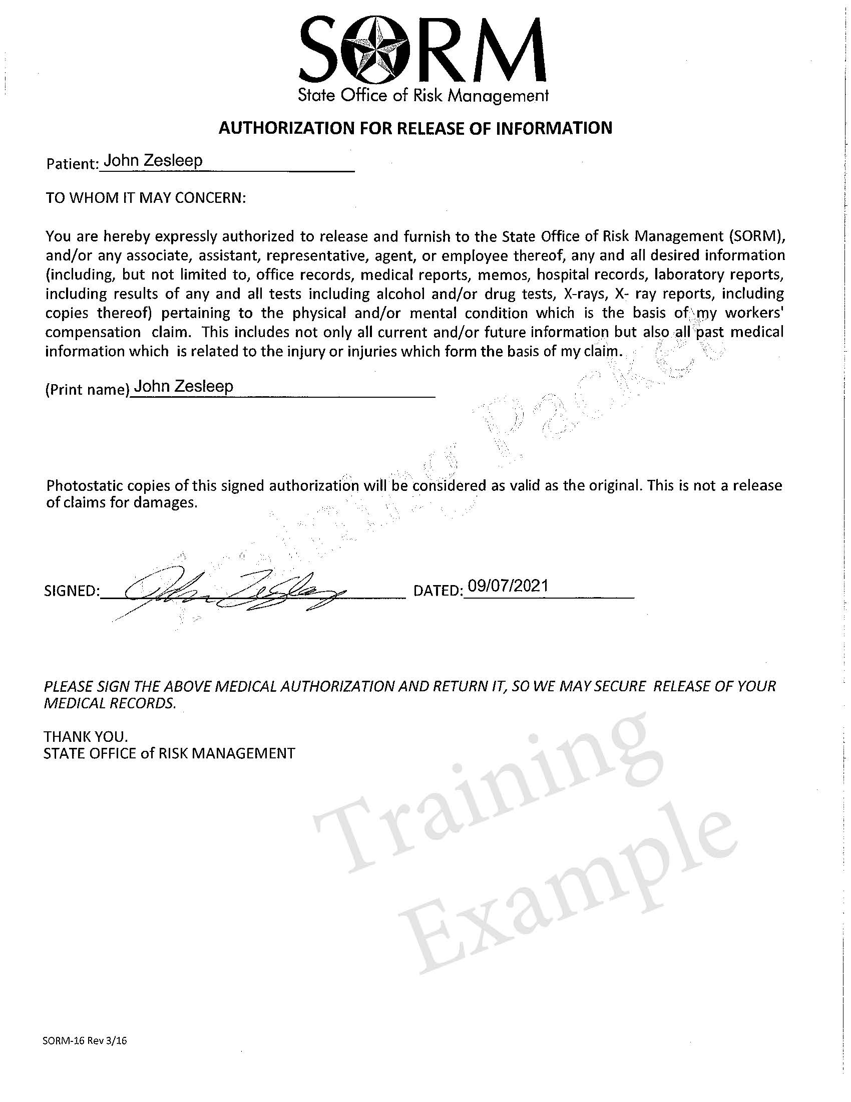
SORM 16
Release of Information
Read and complete the form
CareWorks Network
Read the 5 bullet points and complete the form
TEXAS MILITARY DEPARTMENT
Notes:
Slide Intent:
Suggested Approach:
Additional Information:

Slide 15
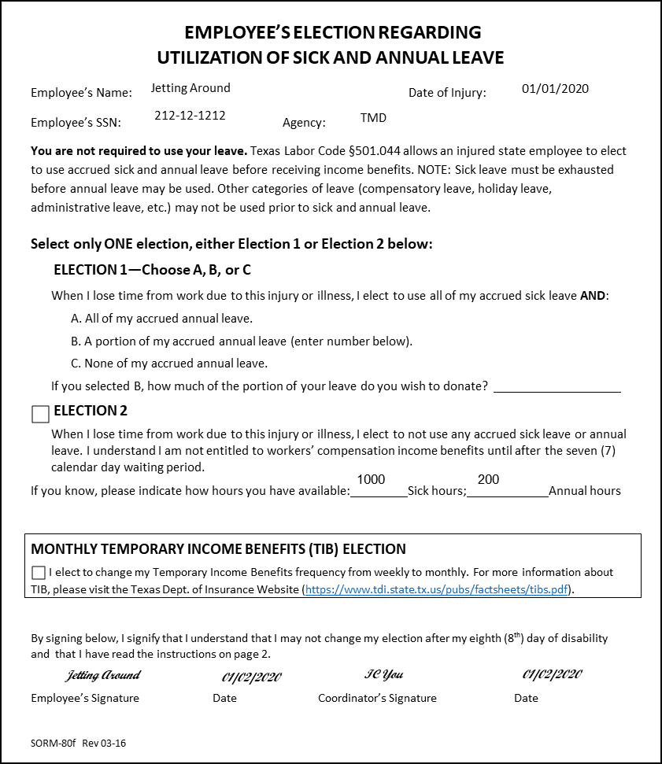
Clarification:
Choose the best
option for you
Election 1A
ALL Sick
ALL Annual
Election 1B
ALL Sick
Some Annual
Election 1C
ALL Sick
ONLY
Election 2
NO Sick
NO Annual
Don’t forget
to sign the form
Training
Example
TEXAS MILITARY DEPARTMENT
Notes:
Slide Intent:
Suggested Approach:
Additional Information:

Slide 16
Training Examples Supervisor NOTE: These are only examples of how to complete the forms.
TEXAS MILITARY DEPARTMENT
Notes:
Slide Intent:
Suggested Approach:
Additional Information:

Slide 17
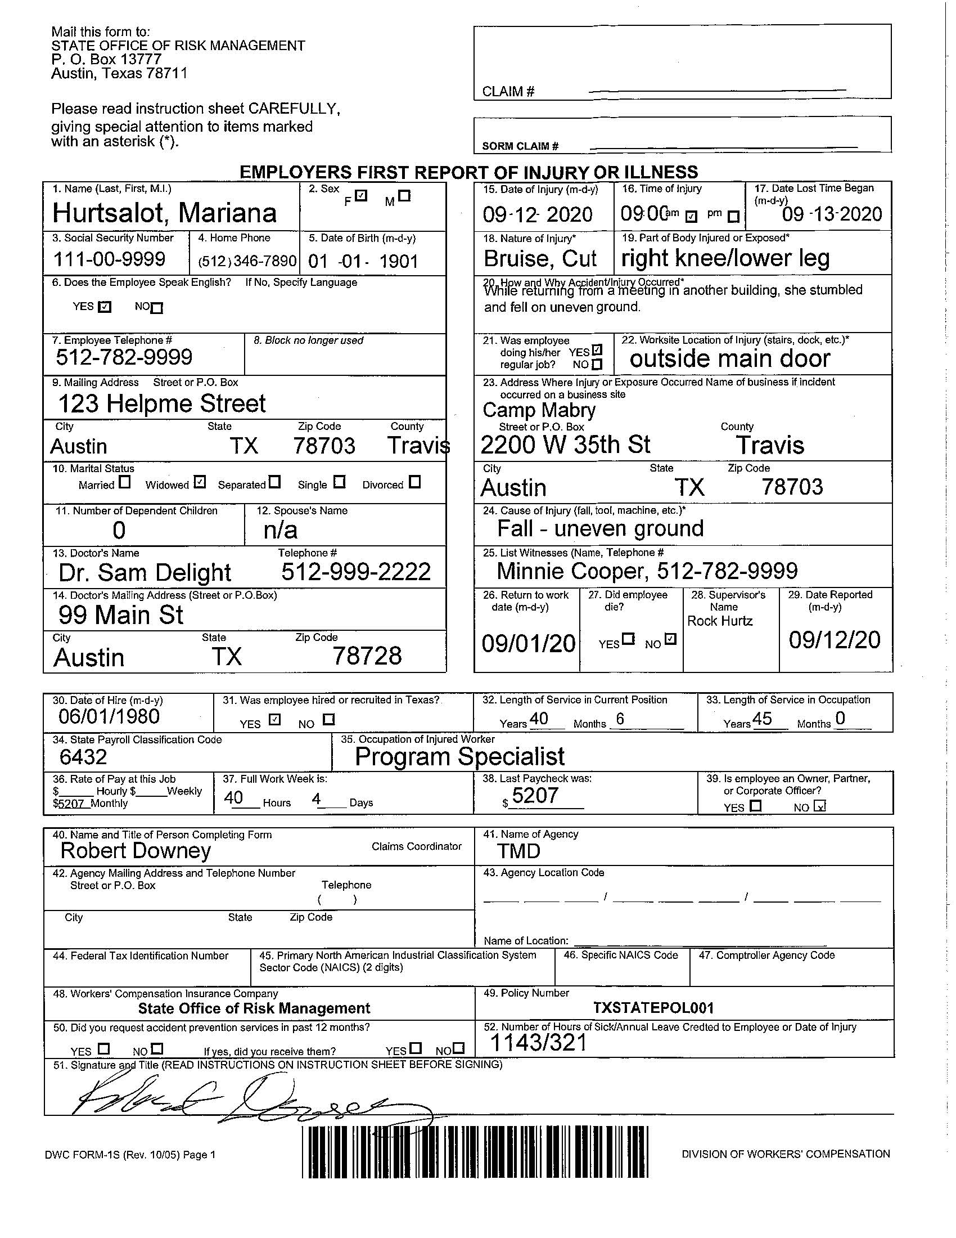
Questions 15-29
Required
Include specific injury information in ALL boxes
Lost time means NO work activity beginning the date after the injury
Complete box 26 if you report lost time
Nature – type of injury
Body parts – be specific
Cause – What caused the injury
Location – where on site
Questions 1-12
Required
Injured Person information
Questions 13-14
Required
Who treated this injury/illness?
Questions 30-38
Required
Use CAPPS to complete
Questions 41-42
Required
Agency – TMD
Agency Code - 401
Questions 40, 42, 51
Required
Person who completed this form
Question 52
Required
How much Sick and Annual leave is available?
TRAINING EXAMPLE ONLY
TEXAS MILITARY DEPARTMENT
Notes:
Slide Intent:
Training example
Suggested Approach:
Additional Information:
Relate the form back to the guidance. Focus this training example for nature, cause, body part, class code, salary (SAD = $1), and doctor information should be for this report only if known. If something does not apply, use N/A to let SORM know it doesn’t apply. The payroll code for SAD is 6402. Encourage the audience to be specific when entering a description and discourage opinions or using generic phrases only like “on mission” or “I don’t know” or “I’m uncertain when this happened” or “I’m not sure”. Focus on what you do know. Occasionally, people use generic terms/phrases as a means to “not be involved”. This is highly inappropriate and could cause additional issues or a negative outcome. In the event of a hearing, the person completing this form may likely become a witness or called to answer questions for this form. If you give appropriate information, it’s less likely this will occur.

Slide 18
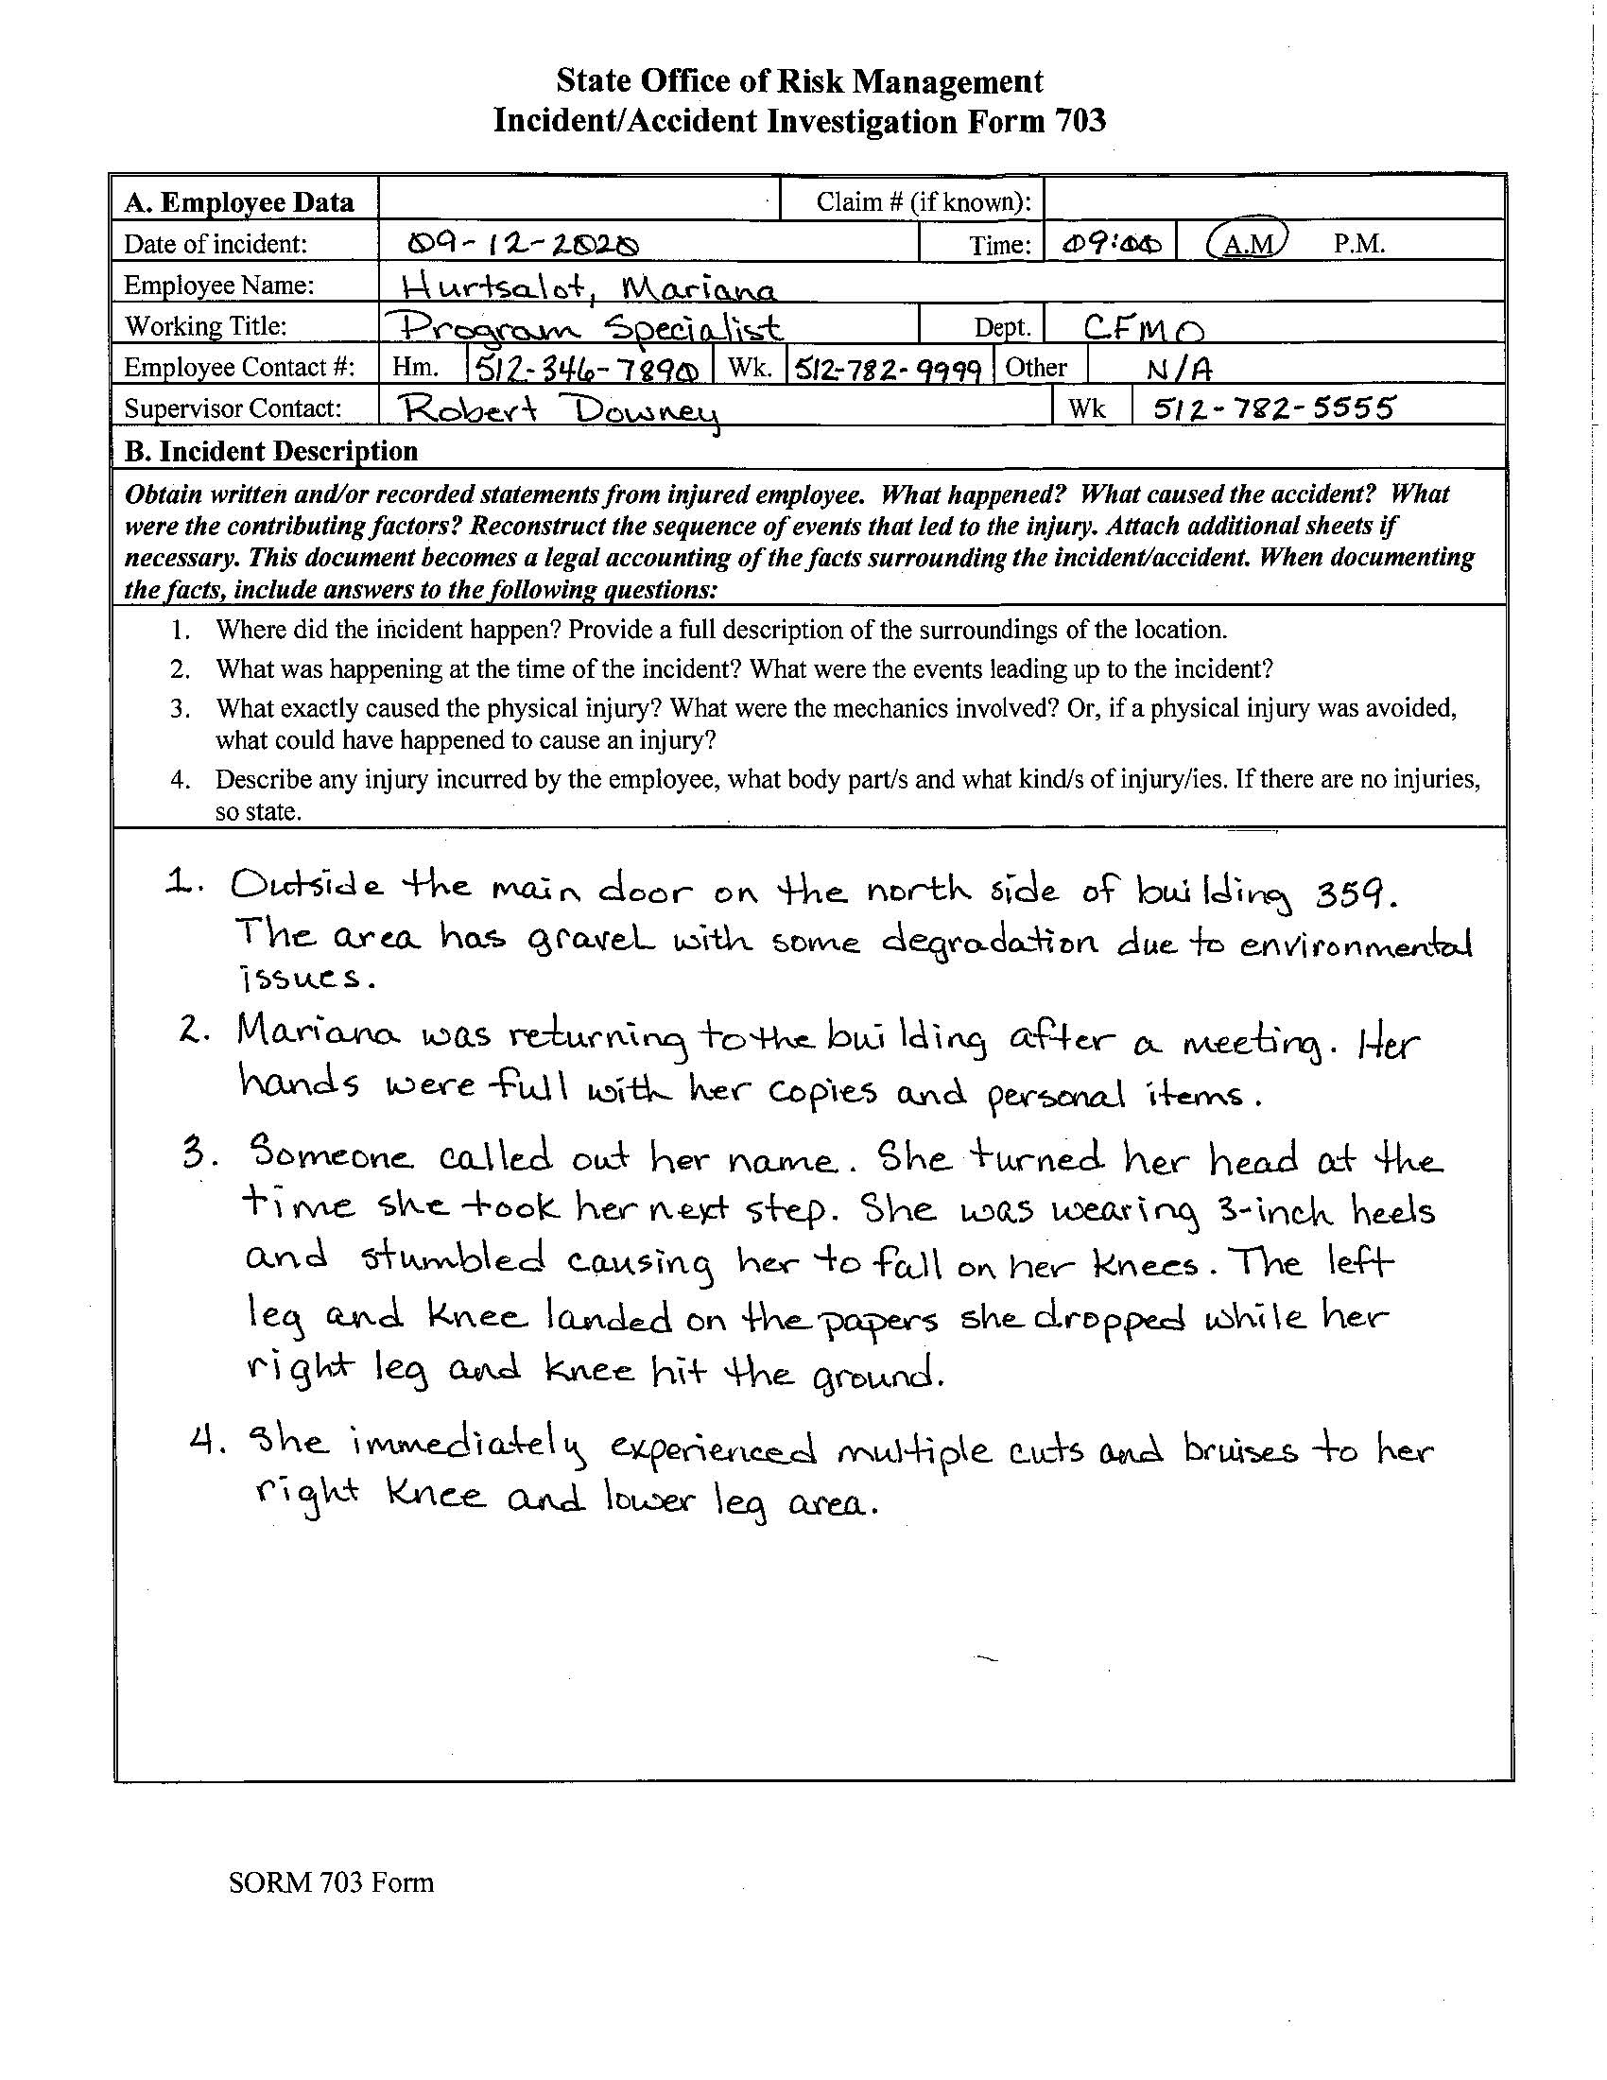
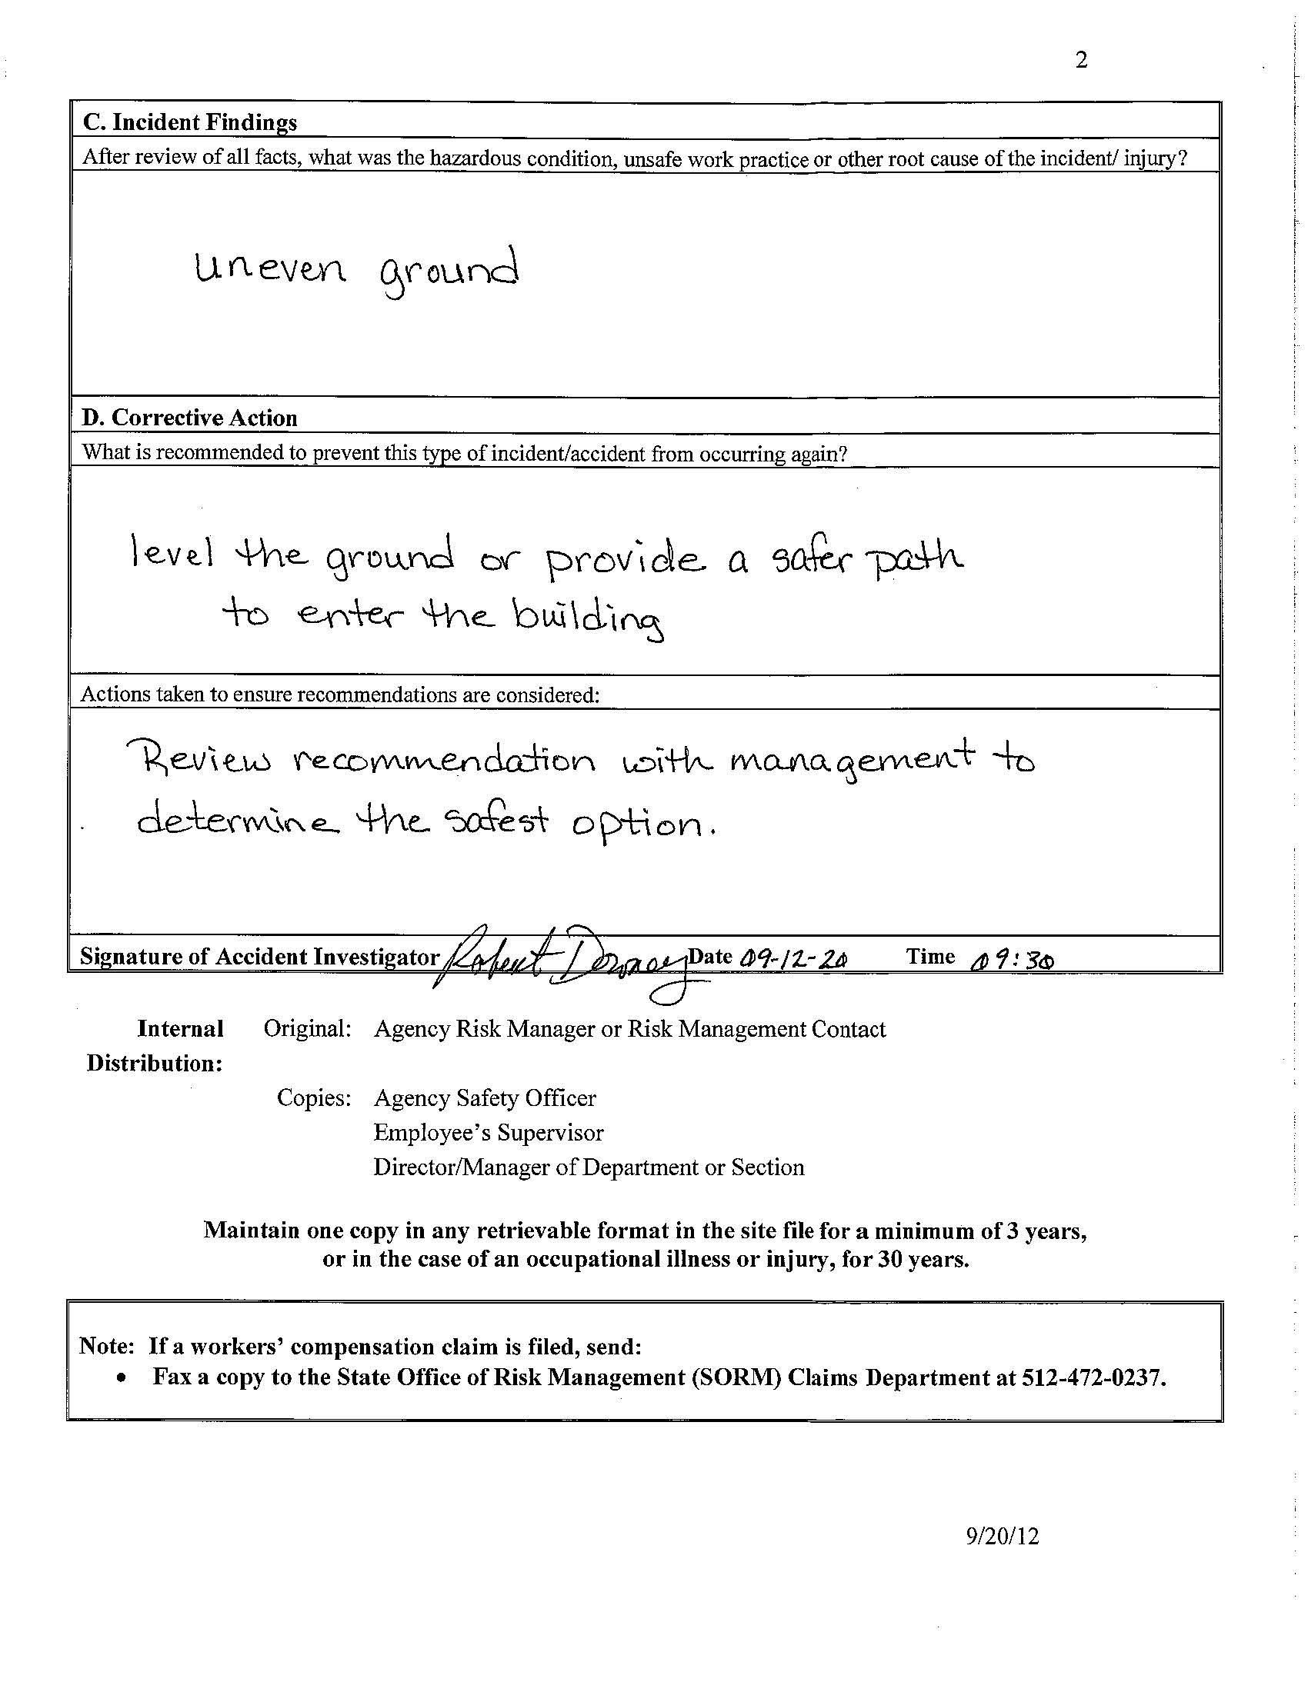
Section A
Required
Complete ALL boxes
NOTE: Put UNKNOWN for claim # unless you know it
Section C
Required
What hazard or act most likely caused this incident/injury?
Section B
Required
Answer ALL questions appropriately
Section D
Required
What can help this NOT happen again?
How does the agency make that action (or similar) happen?
Don’t forget to sign and date the form.
Page 1
Page 2
TRAINING EXAMPLE ONLY
TRAINING EXAMPLE ONLY
TEXAS MILITARY DEPARTMENT
Notes:
Slide Intent:
Training example
Suggested Approach:
Additional Information:
Relate the form back to the guidance. Focus this training example for nature, cause, body part, class code, salary (SAD = $1), and doctor information should be for this report only if known. If something does not apply, use N/A to let SORM know it doesn’t apply. The payroll code for SAD is 6402. Encourage the audience to be specific when entering a description and discourage opinions or using generic phrases only like “on mission” or “I don’t know” or “I’m uncertain when this happened” or “I’m not sure”. Focus on what you do know. Occasionally, people use generic terms/phrases as a means to “not be involved”. This is highly inappropriate and could cause additional issues or a negative outcome. In the event of a hearing, the person completing this form may likely become a witness or called to answer questions for this form. If you give appropriate information, it’s less likely this will occur.

Slide 19
Workers’ Compensation Contact Information TMD, SORM, Network, Pharmacy
NOTE: Medical providers may ask for contact information before treatment
TEXAS MILITARY DEPARTMENT
Notes:
Slide Intent:
Suggested Approach:
Additional Information:

Slide 20
TMD Workers’ Compensation
State Employee and SAD Claims
Marco Aguilar
O (512) 782-5306
F (512) 782-5669
Marco.aguilar@military.texas.gov
Backup Contact
OSA Human Resources
benefits@military.Texas.gov
O (512) 782-5133
F (512) 782-5669
State Office of Risk Management (SORM)
Billing Information
SORM
PO Box 13777
Austin, TX 78711-3777
Claim Information
O (512) 475-1440
F (512) 370-9025
Note: You will be asked to provide a claim number or other identifying information.
CareWorks Network
Pre-Authorization Information
Website
www.careworks.com
Phone
800-580-1314
myMatrixx
Pharmacy Assistance
Phone
877-804-4900
TEXAS MILITARY DEPARTMENT
Notes:
Slide Intent:
Provide contact information
Suggested Approach:
Additional Information:

