Slide 1

STATE ACTIVE DUTY (SAD) – Travel Voucher Guidance
TRAVEL VOUCHER TRAINING
7 June 2023
TMD J1

Slide 2
Key points
Travel Vouchers are filled out and submitted when SMs get ready to EOM (R-JRSOIs).
Only the shortest mileage must be used for reimbursement.
Notes:
- State will only reimburse for the shortest mileage even if a different route was taken.

Slide 3
Required docs
Travel Voucher
Orders
Maps
* All documents will be consolidated and submitted as a PDF doc*
Notes:
- Rename Travel voucher PDF by SM’s Last and First name and voucher year. Ex. Gongora, Sandra_2022

Slide 4
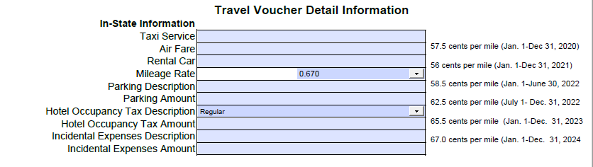
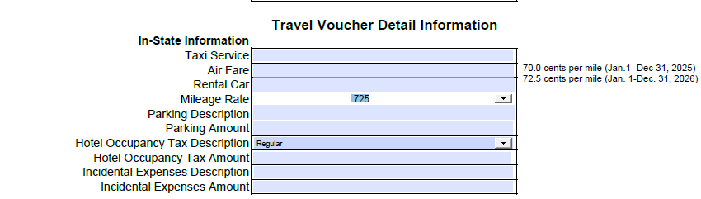
Rates
Notes:
- One Travel Voucher will be submitted for each rate.

Slide 5
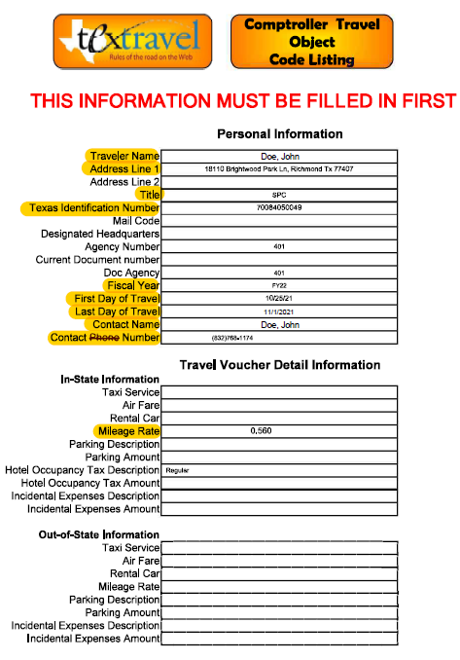
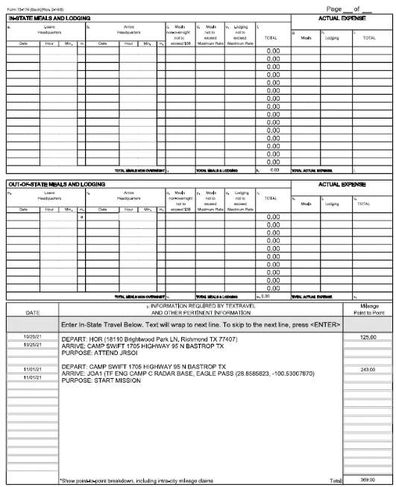
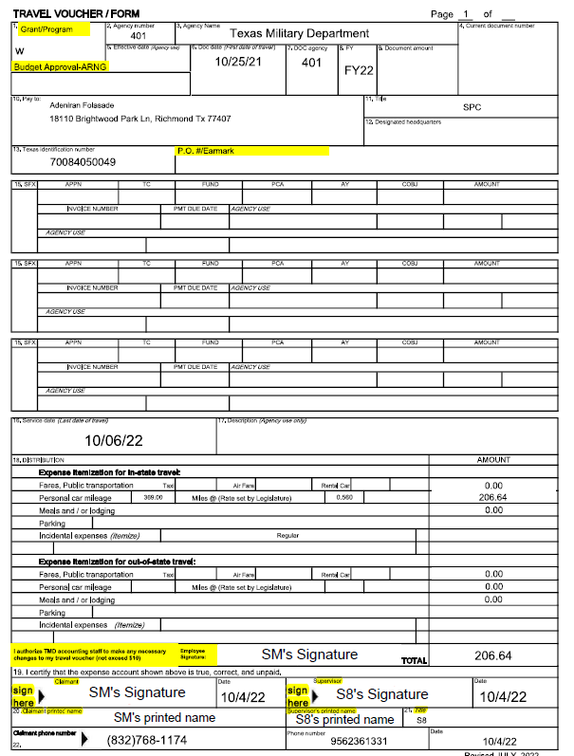
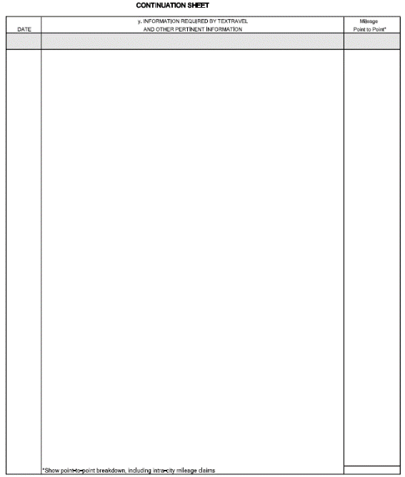
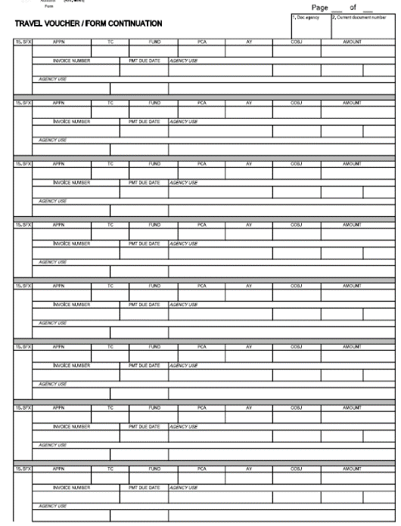
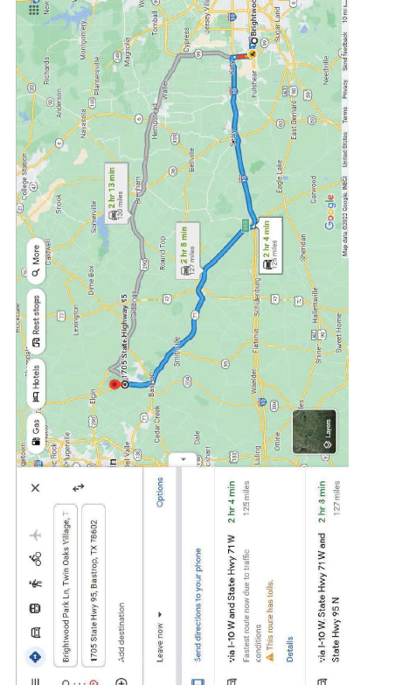
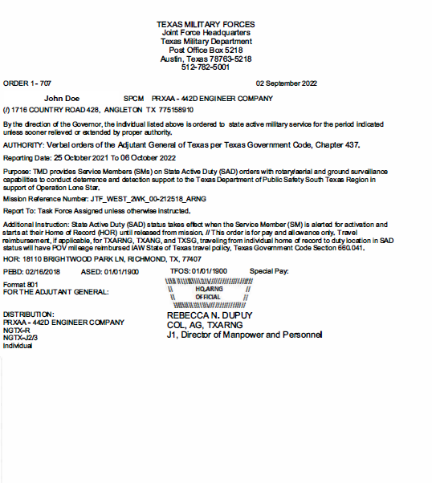
Complete package overview
Page 1
Page 2
Page 3
Page 4
Page 5
Page 6
Page 7
Notes:
- All Travel Vouchers documents should have at least 7 pages.

Slide 6
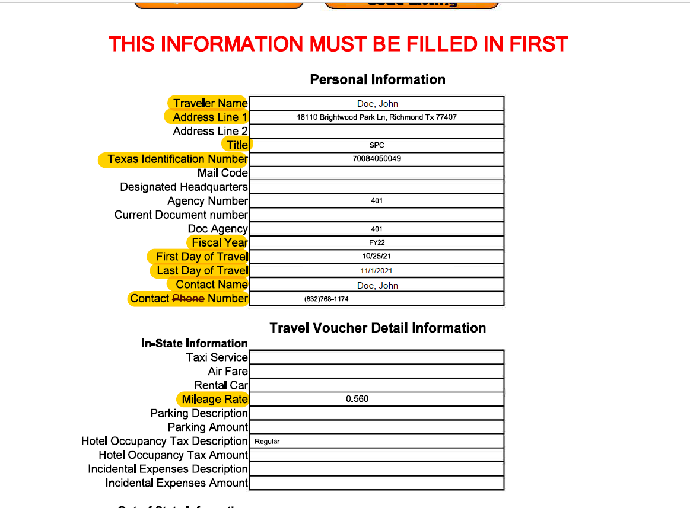
PAGE 1/INFORMATION SHEET
Notes:
Highlighted areas are required.
The Texas Identification Number is always the State ID or DoD.
Fiscal Year is the year the SM traveled.
First Day of Travel is the first day the SM departed in this voucher.
Last Day of Travel is the last day the SM departed in this voucher.
Mileage Rate is the rate that will be paid per mile to the SM according to the dates they traveled.

Slide 7
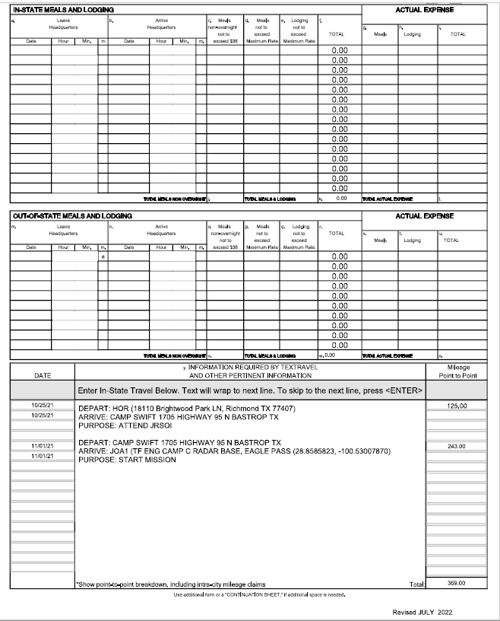
Page 2/MILEAGE BREAKDOWN

Slide 8
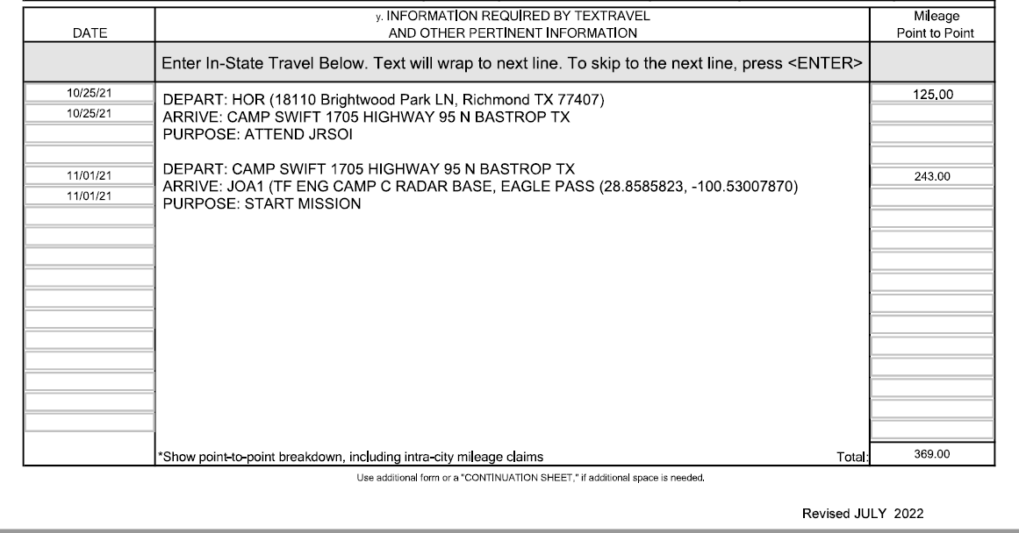
Page 2/MILEAGE BREAKDOWN
Notes:
- Dates must be filled out in order. In this scenario 10/25/2021 is the first day of travel and 11/01/2021 is the last day of travel.
The mileage from point to point must also be filled out. Choose the shortest mileage.
The total at the bottom is calculates automatically
One map per route is required. In this case the SM will have two maps.

Slide 9
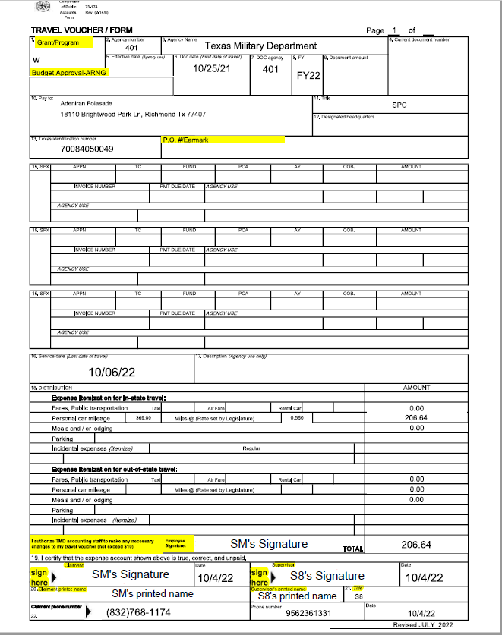
PAGE 3 /TRAVEL VOUCHER FORM

Slide 10
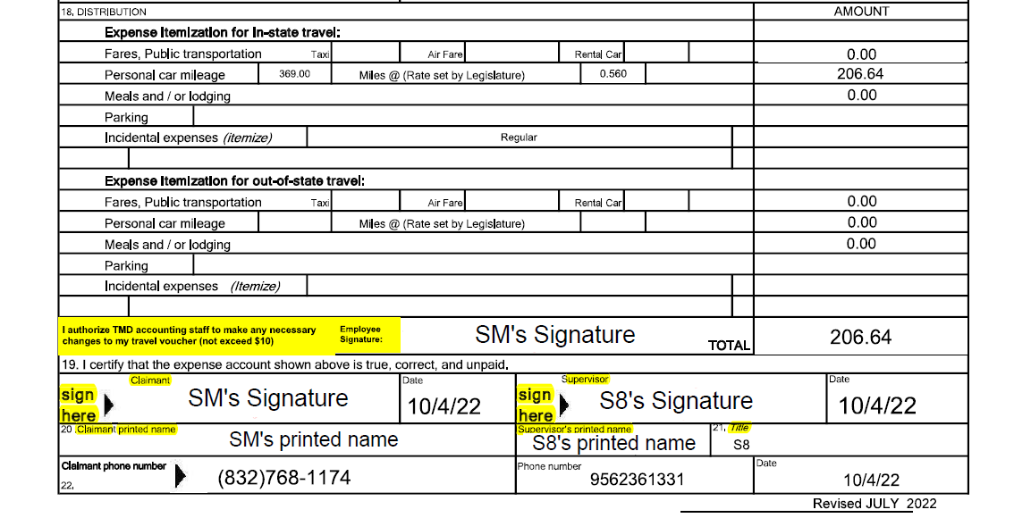
PAGE 3 /TRAVEL VOUCHER FORM
Not required but highly Encouraged
Supervisor Signature
Supervisor Printed Name
Supervisor Title
Required
Notes:
The total paid to the SM is calculated automatically.
SM’s signature allows the TMD to make necessary changes under $10. Ex. If the lowest mileage is not chosen, TMD can pay for the lowest mileage as long as the change is under $10.
Both signatures with signature dates from Block 19 are required. CAC signature preferred.
Block 20 should be filled out (SM’s printed name)
Block 21 should be filled out (Supervisor Signature)
Block 22 should be filled out with SM’s and Supervisor’s phone number

Slide 11
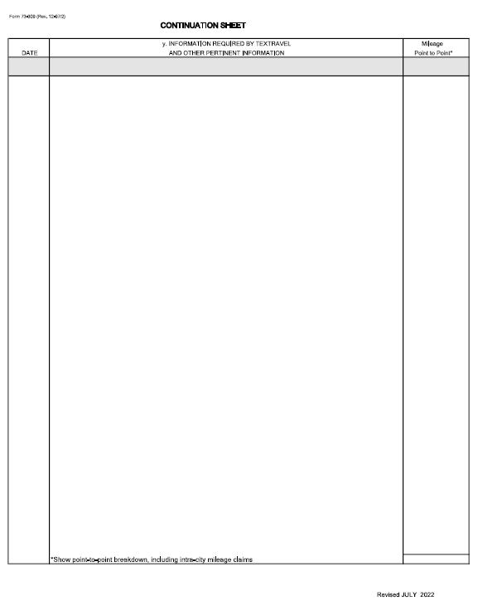
PAGE 4 /continuation sheet
Notes:
- This page is part of the travel voucher but it is usually left blank.

Slide 12
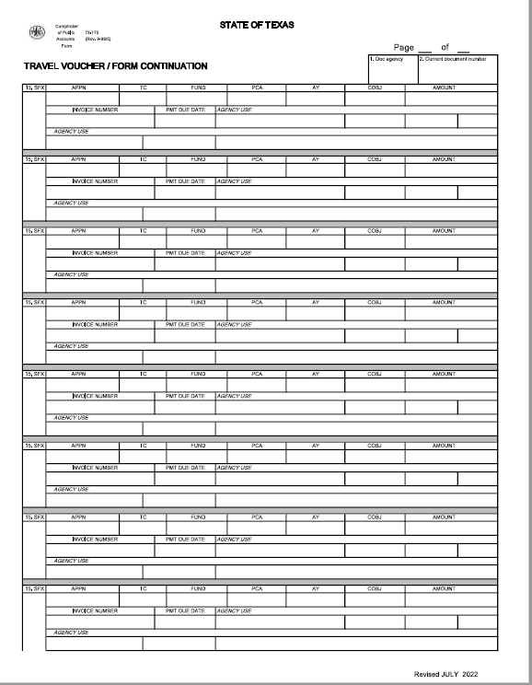
Page 5 /continuation sheet
Notes:
- This page is part of the travel voucher but it is usually left blank.

Slide 13
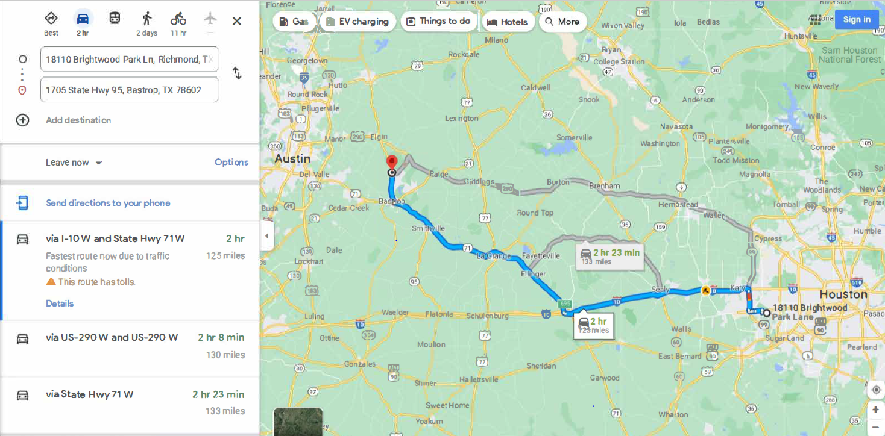
PAGE 6 /MAPS
Notes:
A full picture of the map must be included.
Full picture includes the address departed and address of arrival.
All the different routes
The lines reflecting the different routes.

Slide 14
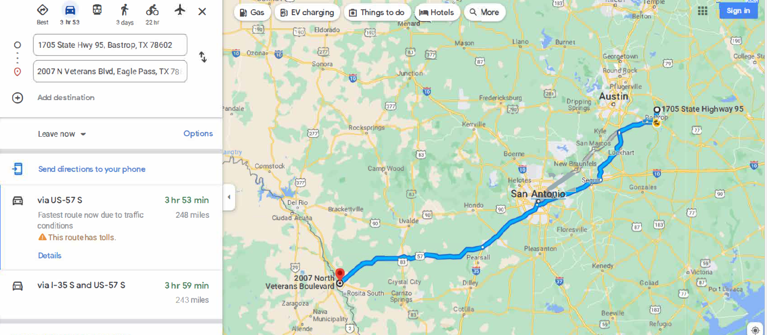
PAGE 6 /MAPS
Notes:
A full picture of the map must be included.
Full picture includes the address departed and address of arrival.
All the different routes
The lines reflecting the different routes.

Slide 15
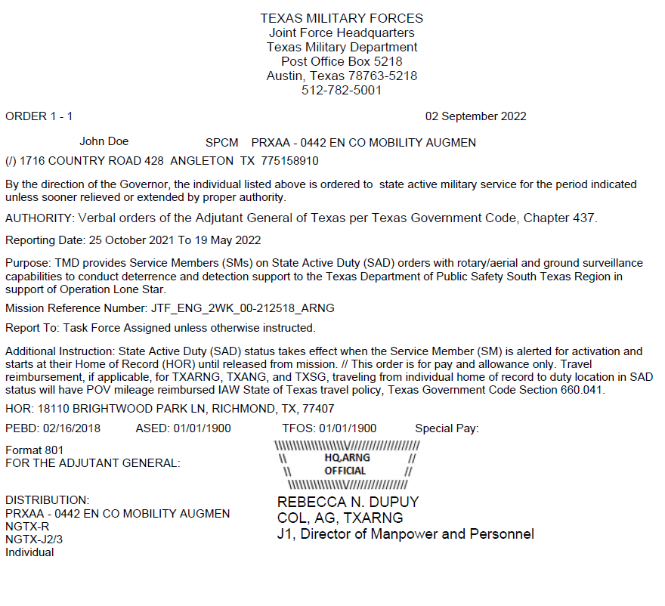
Page 7 /orders
Name must match name on travel voucher form
Order Dates must cover travel claimed
Confirm HOR is correct
Notes:
Name must match
Order dates must cover travel claimed

Slide 16
CAN CLAIM
Mileage from HOR to JRSOI when starting mission.
POV used to Duty Locations
HOR to Duty Location if direct report
Transfer from Duty Location to Duty Location (official reassignment)
Duty Location to R-JRSOI when EOMing
R-JRSOI to HOR when EOMing
*Shortest mileage must be used*
Notes:
The shortest mileage of each route must be used for reimbursement even if the SM did not take that route. State only reimburses for the shortest mileage.
If the SM is switching Task Forces, they can claim mileage for that travel.

Slide 17
Cannot claim
Mileage from duty location to HOR for passes.
Mileage to and from PMEs.
Mileage if transportation was provided
Mileage for daily commute
Notes:
- Only official reassignment can be claimed.

Slide 18
Common Mistakes
No Orders
Orders don’t match
No Maps
Maps don’t match
Missing Signatures
Shortest route not chosen
Notes:
- Vouchers with major errors will be returned for corrections.

Slide 19
Sad Travel mileage reimbursement
1. Incoming
1. Incoming
BLUF: SMs activated under All Hazards OP may be eligible to receive SAD mileage reimbursement, pending approval and availability of funding.
Voucher packer is submitted to SAD Pay team
Travel Voucher Packet is created
Voucher is sent to SM for signature
SM sings and returns Voucher
Start
Submit to All Hazards incoming folder
OLS Pay>OLS Task Force Pay Support Products>Travel Vouchers>All Hazards>Incoming
Team conducts second QC/Changes status on tracker to “Submitted to SAD Pay Team”
Team will input payment number onto the travel voucher tracker.
If issue is found at any level voucher is returned to RNCO for corrections
SM is hired in CAPPS
OSA AP manager approves voucher for payment.
OSA enters travel packet in CAPPS
OSA approves hire in CAPPS
End
Legend
Notes
SM Action
OSA
Action
SAD TM Action

Slide 20
Key points
Travel Vouchers are filled out and submitted when SMs get ready to EOM (R-JRSOIs).
Only the shortest mileage must be used for reimbursement.
Notes:
- State will only reimburse for the shortest mileage even if a different route was taken.

