Slide 1

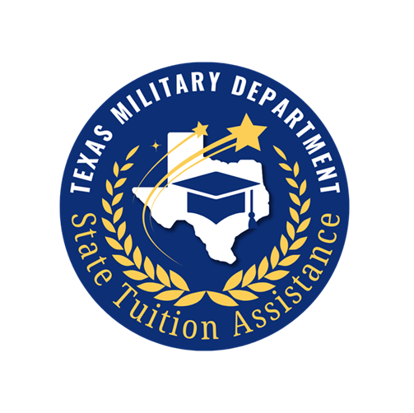

TEXAS MILITARY DEPARTMENT
State Tuition Assistance
AY2026-2027
Mr. Patrick Yonnone, Program Manager
Mrs. Aliea Williams, Program Operations Manager
Mrs. Abegail Hernandez, Program Specialist
Ms. MaryAnne Bell, Marketing/Communication Specialist
Mrs. Emily Cruz, Customer Service Specialist
Mrs. Geiry Alvarado, Compliance Specialist
E&I OIC: LTC Sheri Glenn
Notes:
AW

Slide 2
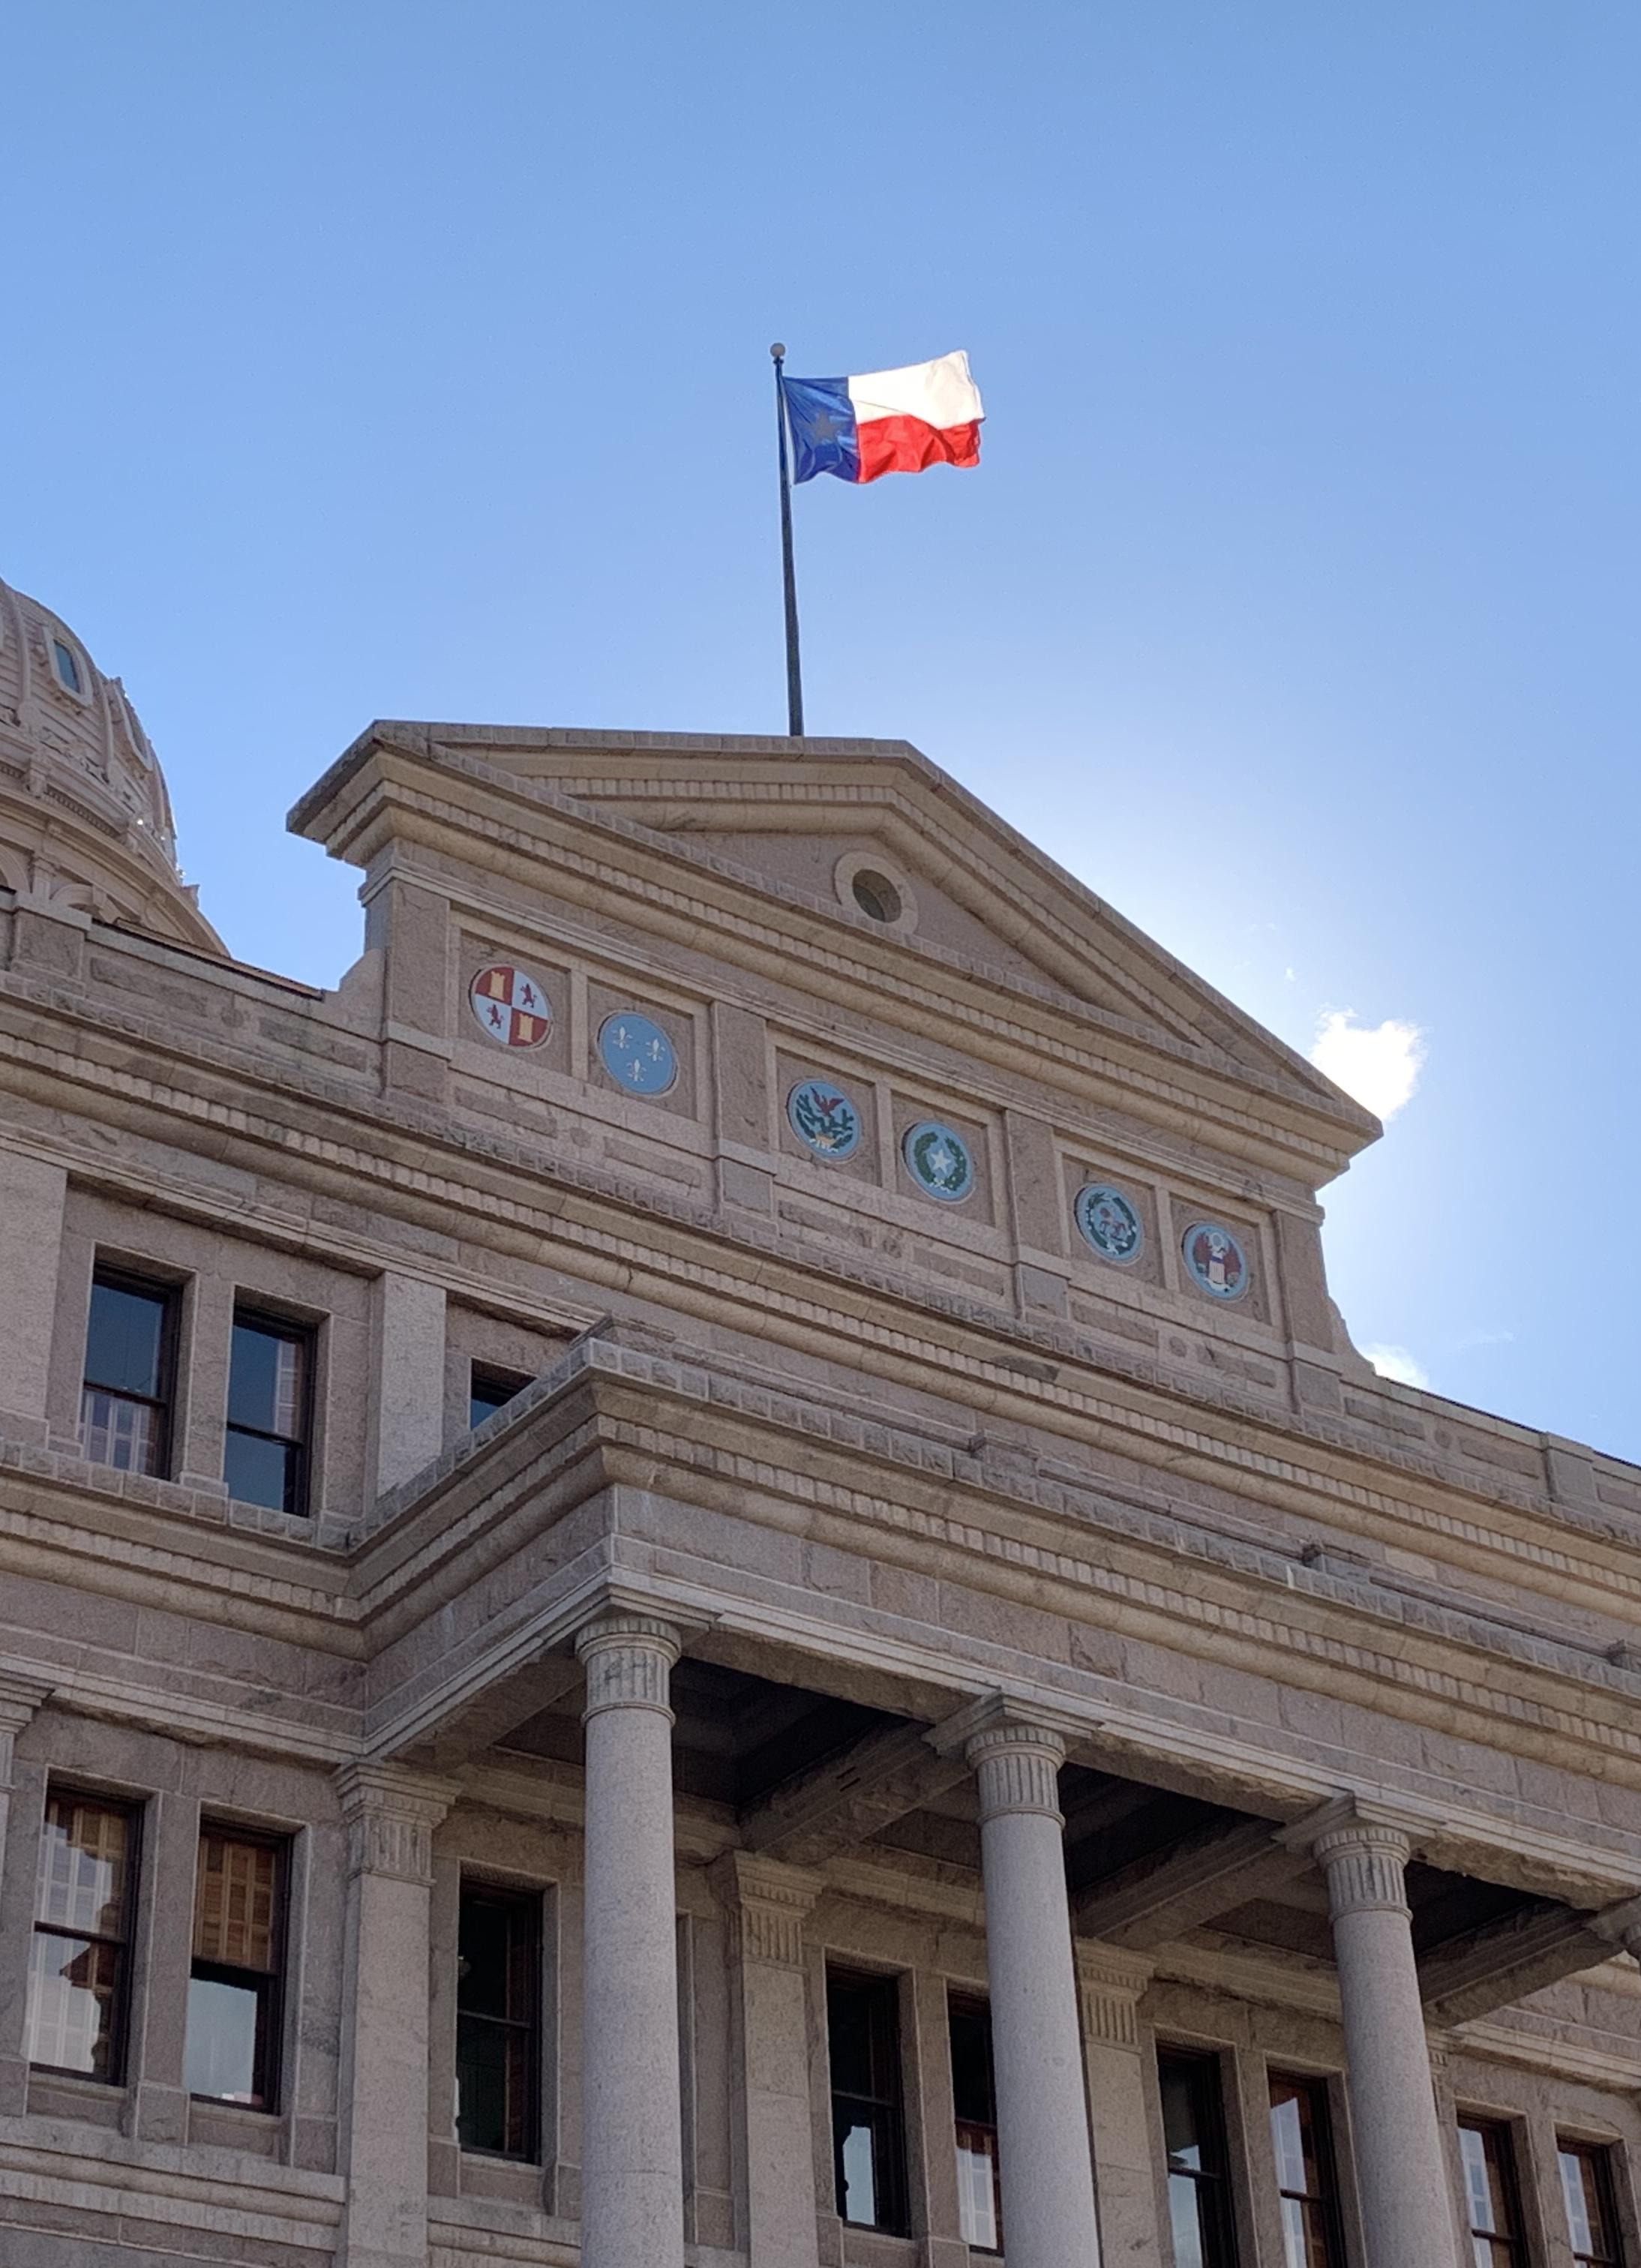
STATE TUITION ASSISTANCE
STA is a needs-based tuition assistance program funded by the Texas Legislature to benefit Texas National Guard and State Guard Service Members.
Because STA operates within a limited annual budget, funding is managed by application window and a base award + adjustment approach.
WHAT’S CHANGED:
Primary Application window for the Fall 2026 semester opened 15 May and closes 15 July. These students will be certified before the semester starts
The Late window will open 16 July and will remain open until the semester closes or all semester funds have been expended.
Notes:
AW

Slide 3
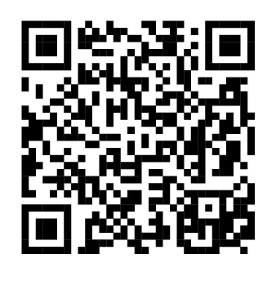
CHANGES!
STA policy is a little more complex this year than in previous years, however it should be simpler for you! We are trying to address 3 concerns:
    Statutory Compliance
    School Processing Procedures
    Refunds
STATE TUITION ASSISTANCE COVERS:
Eligible tuition and fees AFTER other forms of support.
Up to 10 semesters or five years (whichever occurs first.)
Undergraduate and graduate courses including vocational or technical courses at eligible Texas institutions of higher education.*
Private colleges and non-formula programs in Texas are funded at the average public school award amount from the previous semester.
The certified amount plus adjustment (if applicable,) not to exceed 12 credit hours.
*Ed Code 61.003
See website for full eligibility requirements
Notes:
AH & PY

Slide 4
WHO IS ELIGIBLE?
^{Enlisted (E1-E9)}
^{Officer (O1-O5)}
^{Warrant Officer (W1-CW3)}
^{AGR, ADOS, & M-Day}
Actively drilling Service Member in the TXARNG, TXANG, or TXSG. In good standing with unit and serving with no flags.
^{ETS date after course end date}
IMPORTANT CHANGE:
Army ROTC Cadets are required to either complete Basic Training or complete MS2 and receive a valid GRFD control number. Exceptions to Policy are available for prior program participants.
Notes:
AH

Slide 5
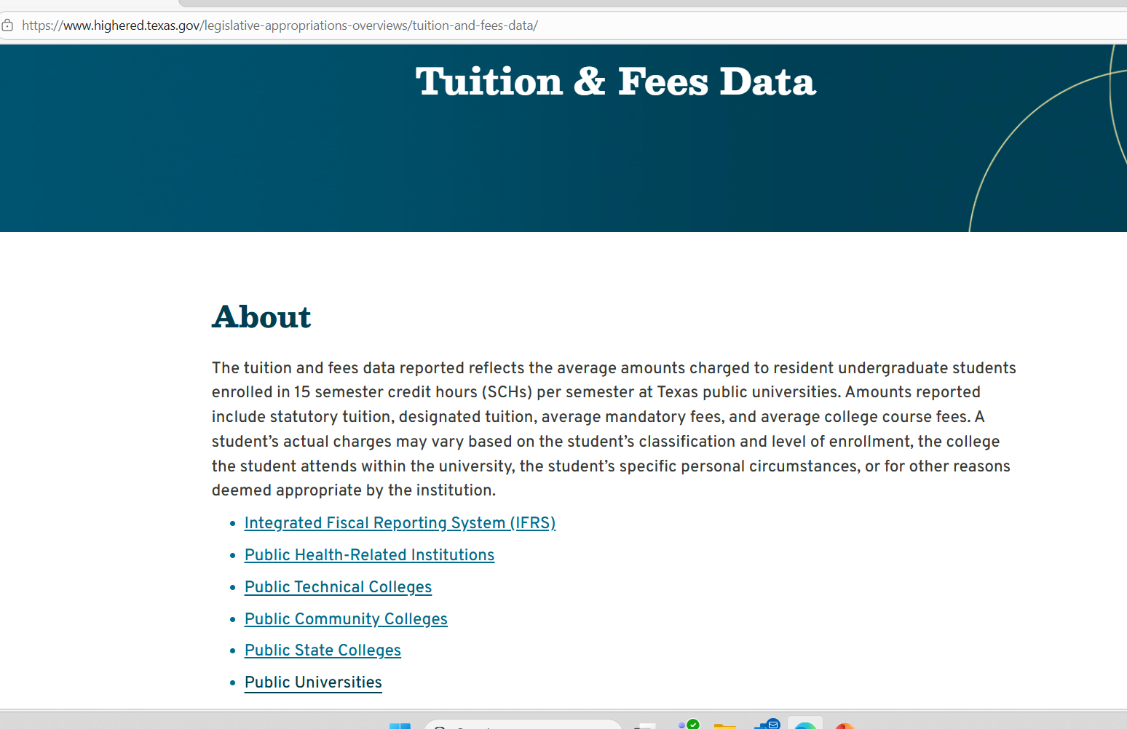
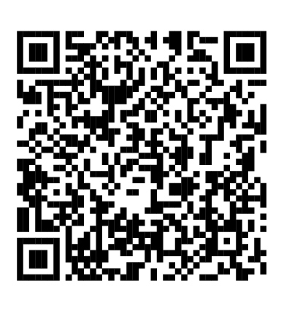
Certified Amount
The THECB publishes total academic charges annually, the STA Certified Award will be based on THECB tuition and fee data.
www.highered.texas.gov/legislative-appropriations-overviews/tuition-and-fees-data/
Notes:
PY

Slide 6
Priority Students vs. Late Students
Students who Apply between 15 May and 15 July will be certified for an award before the semester starts.
Students who apply after 16 July may be certified/identified for an award.
BOTTOM LINE: Eligible Service Members who apply late are not guaranteed an award* by STA and will only be certified after the semester starts.
INTERMEDIATE Q&A (5 mins):
*once STA certifies the student, they will receive an award if they remain eligible, but they cannot be certified before school if they are late, and their certification is based upon available funding; therefore, not guaranteed.
Notes:
EC

Slide 7

NEW! Schools’ STA page
The STA participating Schools’ Webpage is under construction, but it can already be found on the TMD STA website at https://tmd.texas.gov/state-tuition-assistance-program
On the site we’ll include:
Two Sample invoices. One is a PDF and the other is an Excel
document. Both can be downloaded and used as a template.
The STA Process Map for schools.
The Current Flyer to inform about the opening and closing of the
STA application window for the upcoming Semester. We ask for this
downloadable flyer to be printed and displayed in your Financial Aid
Office for our Service Members to see.
The Schools’ Page will also include an Institutional Needs Survey
to be filled out by the school’s POC. Since each institution has
different deadlines and processes, this information will help us
with efficiency.
FAQs. We’ll update as we get more helpful questions.
Announcements regarding changes and important dates.
Notes:
MB/ To strengthen communication and make information easier to access, we’re building a dedicated School Resources page. This site is currently under construction, but it will be completed by July 16th. It will serve as central communication hub for resources, instruction, updates and tools.

Slide 8
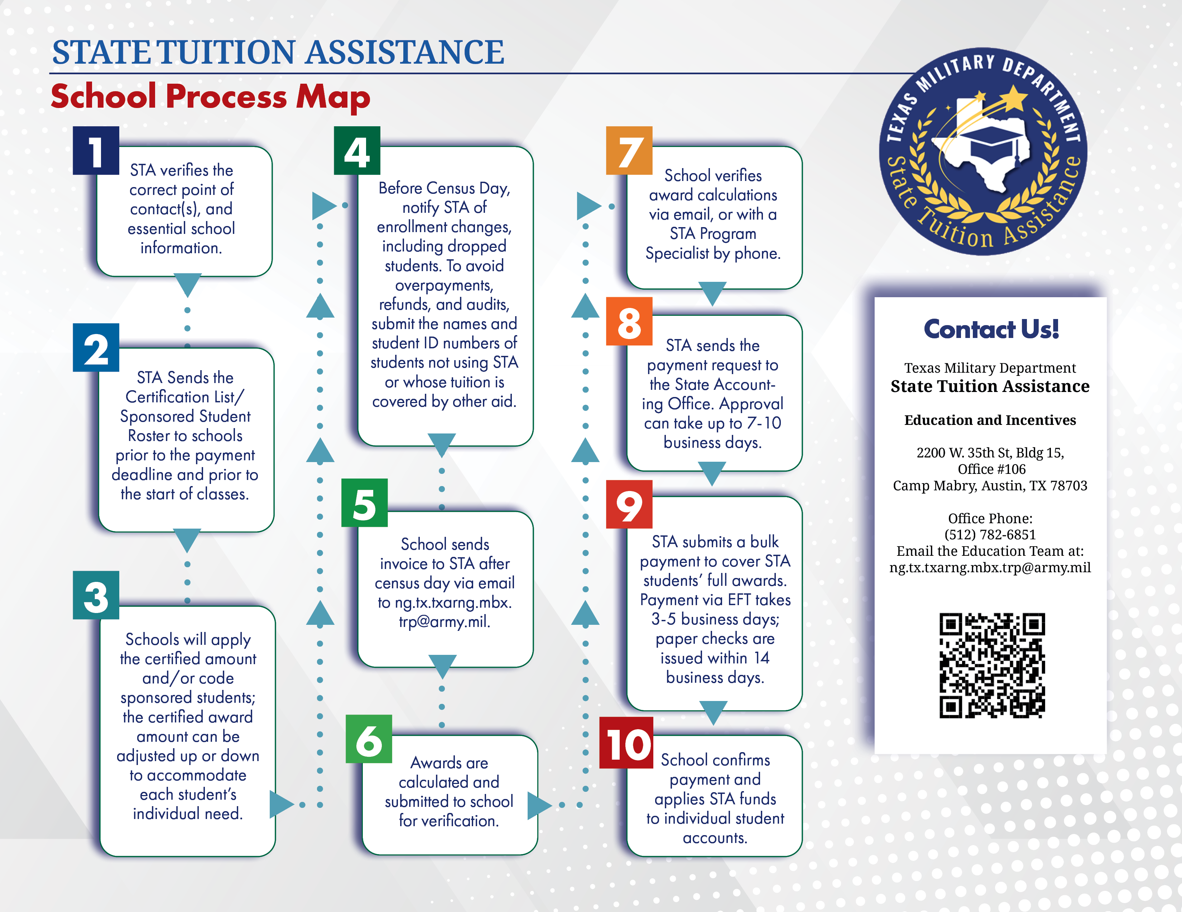
Notes:
EC

Slide 9
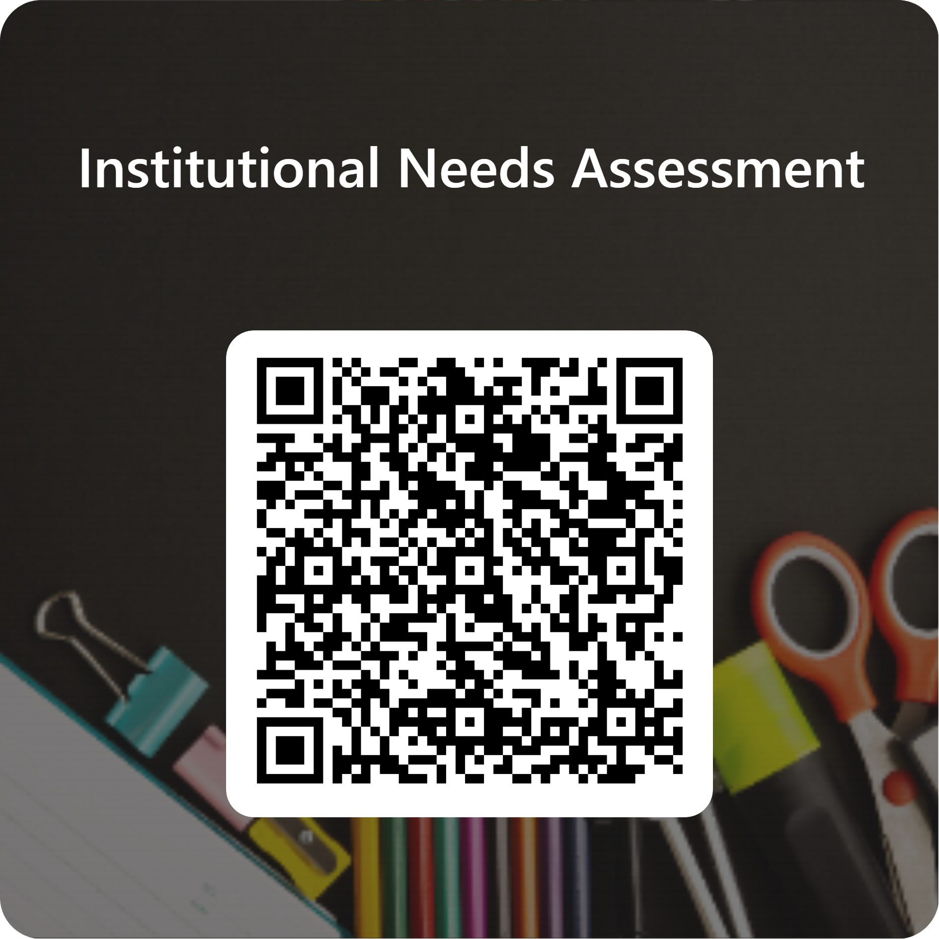
Institutional Needs Assessment
Notes:
MB/ The institutional needs assessment is another communication tool that’s already available on the Schools’ webpage, and this one is asking for your participation.
This is an interactive questionnaire that gives us insight into your department’s specific needs, points of contact, dates and deadlines, and we’ve included a place for you to give us feedback and to ask questions.

Slide 10
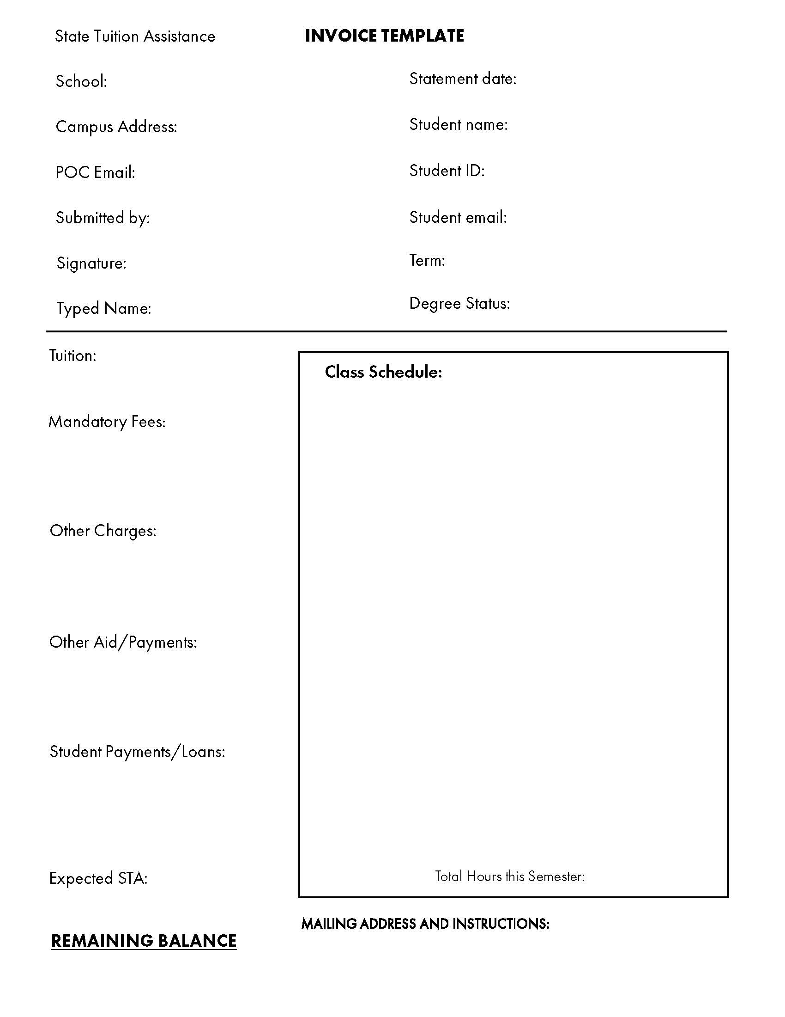
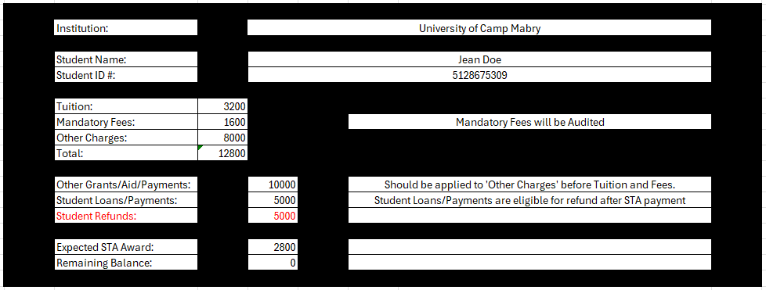
INVOICE TEMPLATE & EXCEL CALCULATOR
Notes:
AW & PY

Slide 11
IMPORTANT NOTE:
Per Statute*, private or independent institutions of higher education are limited to the average public school award amount from the previous regular semester.
This may include non-formula programs, including many trade and professional certificate programs at public or private schools.
*Gov't Code 437.226 paragraph (i)
See website for full eligibility requirements
Notes:
AW & PY

Slide 12
STUDENT REFUNDS
Circumstances where a Service Member receiving STA may receive a refund are listed below.*
Refunds are only allowed through the school - by statute STA can’t refund the Service Member. Because STA is defined as a needs-based program, STA should be applied after other financial aid has been applied to all institutional charges and tuition/mandatory fees remain.
YES:
  Student Payments
  Loans (any type: Stafford, Subsidized, Non-Subsidized)
NO: (not complete list)
  Scholarships
  Grants/Waivers (Ex. Pell)
  Federal Tuition Assistance
  FASFA
  Post 9/11/Hazlewood
*STA is needs based, and if all of a student’s institutional charges are satisfied by other support, there is no need for STA
Notes:
AH

Slide 13
FAQs
How many TMD Service Members are sponsored by STA each semester? While the number has increased every semester for the last two years - for the Spring ‘26 semester, 1,244 Service Members applied; 837 received an award. Between 65%-70% of SMs who apply are eligible to receive an award and have eligible charges.
Can we assign the STA award to the student’s account as a credit as soon as we are notified? Yes. The certified award can be credited upon certification; however, the amount can be adjusted up or down based upon eligible charges.
How does TMD STA let us know which students are covered? We’ll send a roster of SMs who are approved, with a certified award amount prior to class starting.
Can that document include an amount? The certified award will be indicated on the roster; the amount will be adjusted as needed after Census Day.
Will the list of Certified SMs change after the term begins? It can increase due to late applicants; we will sponsor eligible SMs until we expend our budget for the semester. It can also change due to SMs who withdraw from class or lose eligibility.
What format is the Certification list provided in? STA can provide the certification list/roster in a spreadsheet or a pdf list. If requested, STA can create a formal letter for each sponsored student.
Is a State Tuition Assistance award applied before other financial aid? STA is applied to the remaining tuition and mandatory fee charges after other aid has been applied to the student’s balance; STA shouldn’t be combined with other forms of aid to create a surplus in the SM’s student account.
What about Pell grants or other aid that isn’t tuition and fee specific? Pell, SEOG, grants and/or scholarships will be included when calculating the eligible award amount. Grants and Scholarships may reduce the number of qualifying charges that State TA can pay.
Loans or direct payments will not be included in the calculation of the eligible award amount.
In other words, if the SM used student loans or a direct payment to pay tuition and fees,
State TA can still be approved to cover those charges if they are eligible after the application
of all other awards.
NOTE: State TA is not a loan repayment program. Accepting student loans or making a direct payment does not by itself qualify a student for State TA.
Can refunds be sent directly to the Service Member/student (SM)? STA fund cannot be directly refunded to service members or students.
STA should not exceed eligible tuition and mandatory fee charges after all other forms of aid have been applied.
If a student receives STA and a refund is generated, that refund should not exceed payments the student personally made or the value of a loan taken out to satisfy tuition and fee charges. In that case, the refund represents the student's own funds being returned, not STA funds.
Will STA recoup funds from a SM who dropped late or who failed a class? Service members are financially responsible for any course that does not result in a passing grade or successful completion. If funds must be recovered, TMD will pursue repayment in the following order:
    School refund (preferred): the school returns the funds directly to TMD.
    Future award reduction: if the SM applies to STA in a future semester, the award will be reduced by the amount owed.
    Comptroller payment-hold: unresolved debts may be reported to the Texas Comptroller's office, resulting in a warrant or payment hold.
    Attorney General collection*: After 90 days, the Comptroller reports unresolved debts to the Texas Attorney General's office for collection actions to include reporting the debt as a state delinquency on the student’s credit report.
* This is a serious financial obligation, repayment via the school is the fastest and preferred resolution.
Defining some fees as “Mandatory” or “Non-Mandatory” Fees is confusing as some fees, such as distance learning fees are mandatory for our students who can only take classes remotely – is this a rule or a suggestion? Mandatory Fees are either authorized by statute or the governing board of your institution. Fees should be obligatory and consistent for all students to be considered ‘mandatory.’
Note: If Mandatory Fees exceed more than 30% of a student’s bill it may trigger an audit by STA.
Since STA is last payer, when STA is applied and a student is later awarded or accepts a scholarship/grant, are we expected to adjust the STA award amount? Yes. This is consistent with STA being last payer.
Our system can’t track whether a specific sponsor has covered a class before. Can STA require SMs to submit their list of classes before funding is approved so STA can check for duplicate and repeat classes? STA tracks each SMs course history by requiring them to submit their previous semester transcripts. It’s noted on their account if they have failed a course and if their cumulative GPA has fallen below 2.0.
Notes:
PY & AW

Slide 14
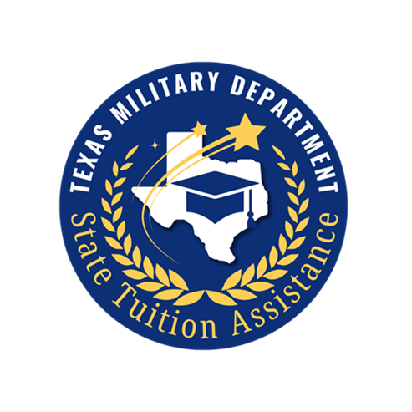
Contact information
Phone: (512) 782-5270 or (512)782-6851
Mon-Fri 0800-1600
Email: NG.TX.TXARNG.MBX.TRP@ARMY.MIL
Website: https://tmd.texas.gov/state-tuition-assistance-program
https://tmd.texas.gov/for-schools (under construction)
TEAMS: TXARNG Education and Incentives
Office: 2200 West 35th St Camp Mabry, Building 15
Follow us on Social Media:
www.facebook.com/TexasArmyNationalGuardEducation@TXARNGeducation Public

