Slide 1
Newcomer’s Brief
Updated September 2015
Lt Col Travis “TD” Walters

Slide 2
Our Agenda
Commander’s Intent
Who I Am
What I Expect
What You Should Expect of Me
My Priorities
My Non-Negotiables
Conclusion

Slide 3
COMMANDER’S INTENT
“The 136th Maintenance Squadron will execute on order … the production and projection of effective combat power and domestic support … anywhere, anytime and for any user … as deemed necessary by the appropriate chain of command. The efforts of this Squadron … to the person … will focus upon and center around this very intent.”

Slide 4
So Ask Yourself Daily…
Am I ready?
Are the Herks ready?

Slide 5
Who I Am
Wife of xx years: (name here)
Children: (names, ages here)
Grew up in Nashville, TN
Former C-130 pilot (medically disqualified)
A few HHQ staff assignments
Work at state HQ on weekdays, live in Austin
First assignment as a Maintenance Officer
I’m here because I want to be!

Slide 6
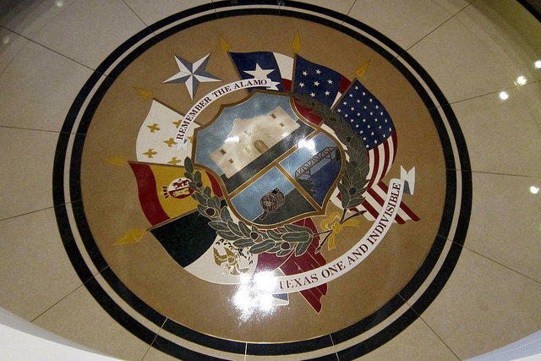
Who I Am Continued

Slide 7
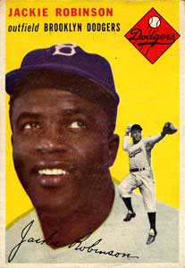
What I Expect
Mission Focus
Meet Standards & Be Ready
Embody Core Values
Professionalism always in our Profession of Arms (even as the rules change…just ask Jackie)
Live by the “Little Books”
Little Blue Book (AFI 1-1, Standards)
Little Brown Book (AFI 36-2618, The Enlisted Force Structure)

Slide 8
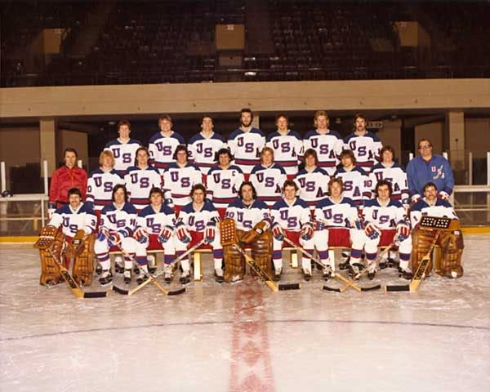
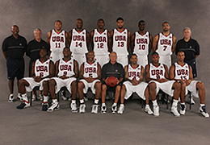
What I Expect Cont.
Be a Team and a Family…cause the “team” with the best individual players doesn’t always win
1980 Olympic Hockey Team
Gold Medal Winners… beat the Soviet Union
2004 US Olympic Basketball Team Lost to “Powerhouses”:
Lithuania, Puerto Rico & Argentina

Slide 9
What You Should Expect of Me
Expect of Me the Same Things I Expect of You
To Lead and Mentor
To Take Care of You to the Best of my Ability
To Enforce Standards
Be Responsible & Accountable for our unit’s Conduct and Performance
Build & support supervisors who lead by example, mentor/care for their people, and meet standards

Slide 10
My Priorities
People & Standards…to enable you to Focus on the Mission
Be a Coach, Teacher, and Mentor
Safety…avoid Dumb, Dangerous, or Different and Increase our Resiliency
Foster an “Airman First” Culture
Work Hard, Play Harder

Slide 11
My Non-Negotiables
Integrity issues…our sacred trust starts today
Unprofessional attitudes or behavior
DUIs, drugs, financial, customs & courtesies
Discrimination of any kind…race, gender, religion, etc.
Sexual harassment, jokes, language of any kind
Disregard for rules/standards/regulations (laws, AFIs, OIs, …)
For supervisors: tolerating any of the above from subordinates, especially in your presence

Slide 12
Our Unit Needs You
Old Herks, Young Mechanics
ANG is rapidly Changing & Evolving
I really need each of you…
I don’t make the mission happen…you do
I don’t have all the answers
I desire feedback and welcome new ideas
I want good for you…and our squadron family
We absolutely can succeed together and reach heights you never thought possible!

Slide 13
Who We Work For

