Slide 1
SERVICE COMMITMENT
1-2 Days Per Month of Training
4 Days Per Year Annual Training
State Active Duty Response
ELIGIBILITY REQUIREMENTS
Texas Resident for 180 Days
Possess a Texas Driver’s License
18 – 70 Years Old
Pass Background Check
Meet Physical Standards
Pass Medical Review
Recruiter’s Information:

Slide 2
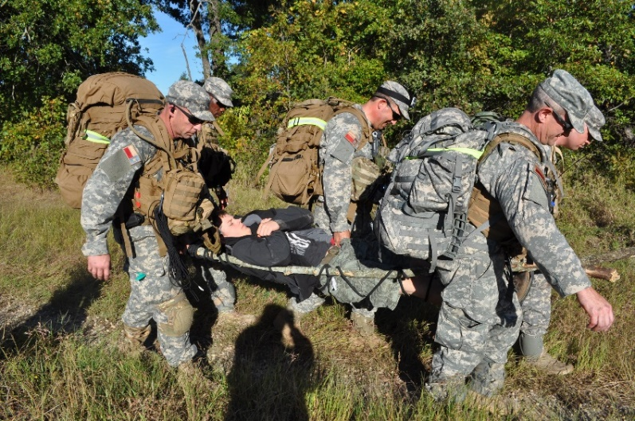
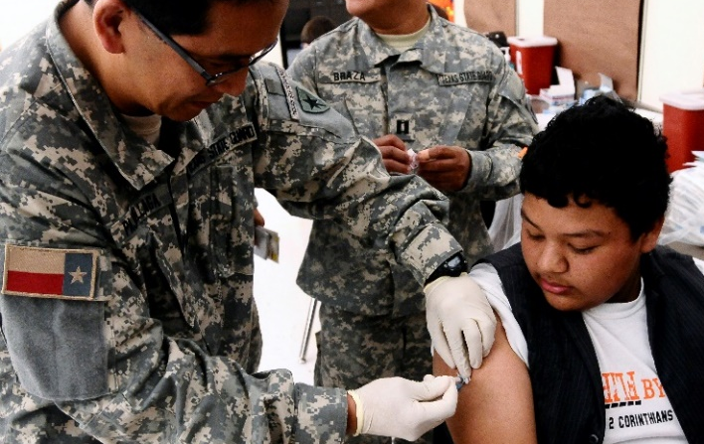
DUTY – HONOR – TEXAS
COMMUNITY SERVICE
As a member of the Texas State Guard you will directly serve the people of your community when they need you most.
The Texas State Guard prepares year round to respond when activated by the Governor. Our Guardsmen deploy alongside Texas Army and Air National Guard members to support state and local governmental agencies when disasters occur.
STATE GUARD DOM OPS
SHELTER OPERATIONS
Deploy teams to assist with the organization
and operation of disaster response shelters.
EMERGENCY TRACKING NETWORK
Provide Guardsmen trained in the operation of tracking networks for displaced individuals.
ADAPTIVE BATTLE STAFF
Subject matter experts provided for support and staffing of the State Operations Center.
EMERGENCY OPERATON CENTER
Augment emergency operations centers with Web EOC capability.
STATE OPERATIONS CENTER SUPPORT
Provide Texas Dept. of Emergency management with intake and mass care cell specialists.
INTEROPERABLE COMMUNICATION
Connect incident command posts across state via voice and data platforms.
RADIO OPERATIONS
Mobile repeater systems and communication towers extending range of radio communication.
SITE MANGEMENT
Logistical experts trained to support Texas Forestry Service in wildfire abatement.
GROUND SEARCH & RECOVERY
Deploy search and recovery teams to locate missing persons and aid local authorities in recovery ops.
WATER OPERATIONS (BOAT)
Water-borne search and rescue provided during floods or hurricanes.
WATER OPERATIONS (DIVE)
Deploy guardsmen to support local authorities with underwater dive and recovery operations.
LOCAL SERVICE
Texas State Guardsmen do not deploy overseas. They serve as a military force working locally and state-wide as needed.
The Texas State Guard is always-ready to deploy by orders of the Commander in Chief, the Governor, of the State of Texas when needed.
https://tmd.texas.gov/join-the-state-guard

