Slide 1
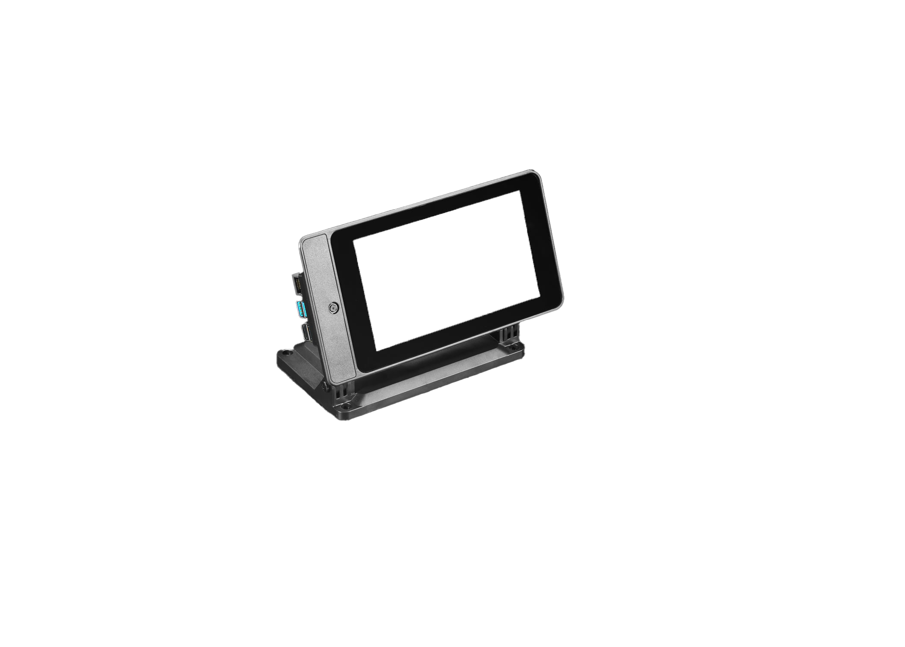
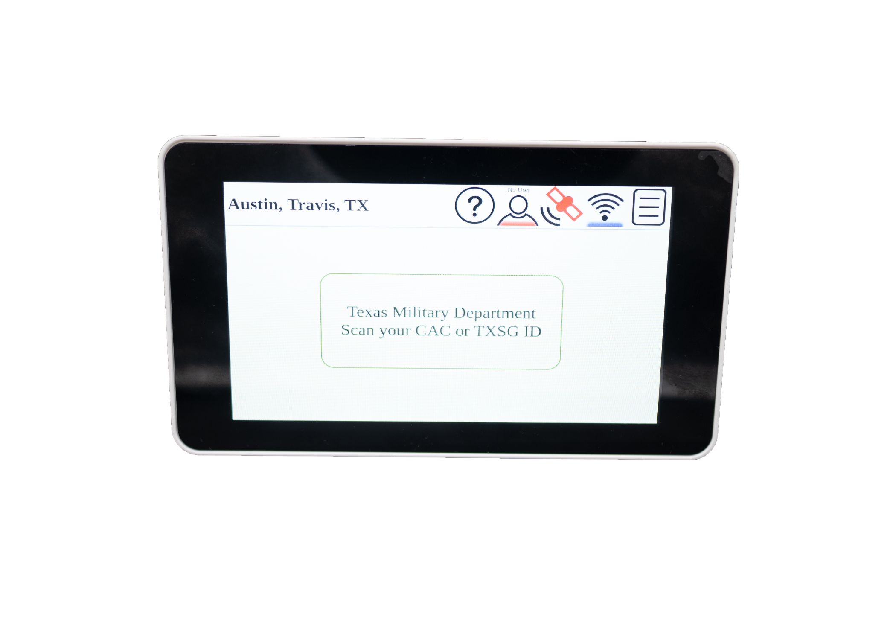
ViQue Kiosk User Guide
Presenter Name

Slide 2
Agenda
What does it mean
Set Up
Operation
FAQ
Question
POC

Slide 3
What Does it Mean
The ViQue Kiosk is one of several ways to take attendance. It is a single purpose device for high-speed attendance taking to help improve accountability processing.

Slide 4
Set Up
ViQue set up, components, application, and troubleshooting the scanning device

Slide 5
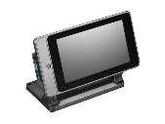
Hardware
Listed below are the basic components of the ViQue scanner system which enable plug-and-play operations:
Kiosk
Power cord
Charging brick
Scanner

Slide 6
Software, WiFi, & Application Configuration of ViQue Scanner

Slide 7
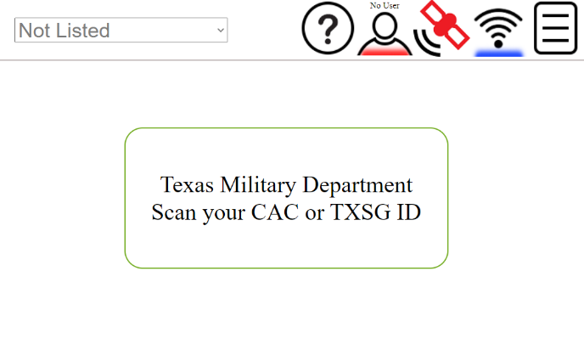
Software
Scanner software and applications are preloaded on the device. The scanner can work connected to the local internet/Wi-Fi or a stand-alone device that can store information and be downloaded at later times to the specific database.

Slide 8
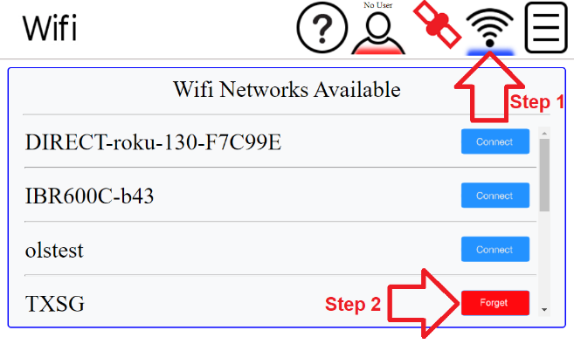
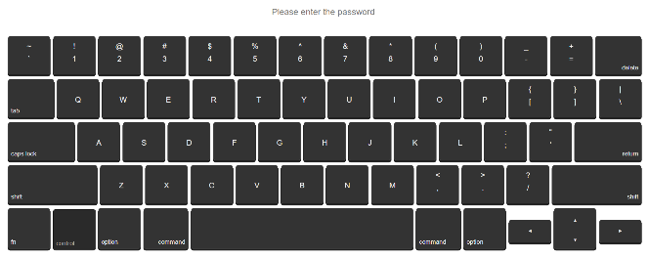
WI-FI set-up
The ViQue Kiosk can connect to any WiFi network. Select the WiFi icon on the Kiosk and search the list for your organizations WiFi or mobile hotspot network.
1
2
Type your password and press the “return” key

Slide 9
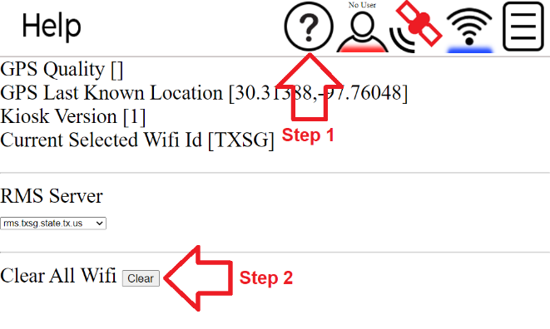
Troubleshooting WI-FI
If the system fails to connect, select the help icon tab and click the “Clear All WiFi” button. Once completed, return to the WiFi configuration tab and attempt to reconnect.

Slide 10
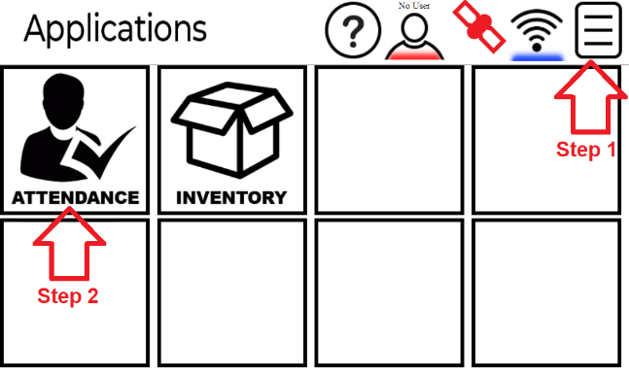
Application
Select the application tab in the upper right to access the ViQue Kiosk applications. Choose the application that you want to execute under the appropriate tab. In this scenario, select the “Attendance” application.

Slide 11
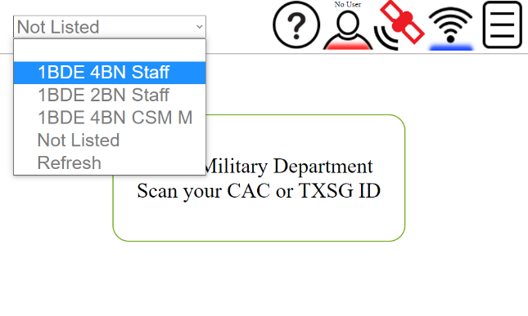
Attendance: Choosing the proper event
Once in the attendance application, select the drop-down list in the upper left. Choose your specific event, unit, or mission under the events tab. Please ensure you choose the correct selection.

Slide 12
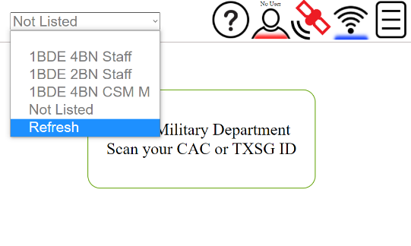
What if my event is not in the list?
Note: Updating/adding events require JRMS access to complete.
A new event must be created an event in JRMS if it does not exist and wait 5 minutes for it to be available to the kiosk. Note: The kiosk must be on a Wi-Fi network to receive events from JRMS.
Make sure you have waited 5 minutes since the creation of the event.
Make sure you are on a Wi-Fi network that can get to your JRMS server.
Click refresh to get an updated list of events that your kiosk has been given.
If you are unable to find your event, select “Not Listed”

Slide 13
ViQue Kiosk Scanning Operations
Once setup is complete, follow these steps for attendance operations.
Configure your Wi-Fi
Select the Attendance application
Select your event
Scan either your CAC card or TXSG ID

Slide 14
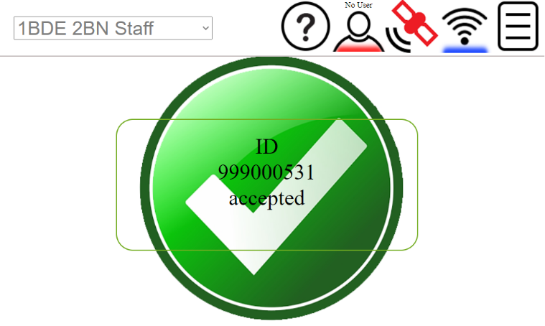
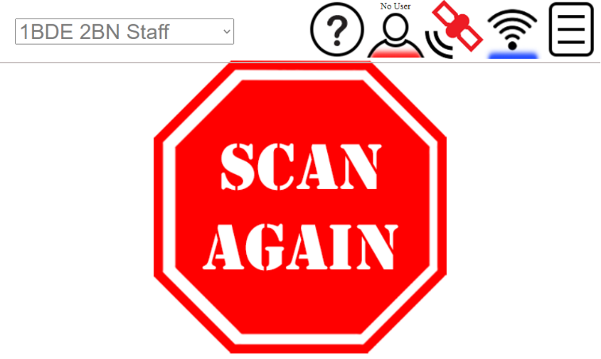
Scan Examples
Once the CAC or ID card is scanned, the following images will display if the scan was successful or if it failed.
If the scan fails, attempt to scan the card again.
Example of a successful scan
Example of a failed scan

Slide 15
Frequently asked questions
Is it waterproof?
No, it is not.
Does it require an outlet?
Yes, it does. The system does not have battery power.
Does it require WiFi?
Yes, it does. However, it can operate in offline mode until a network connection can be established. A network connection is also required to sync for any updates.

Slide 16
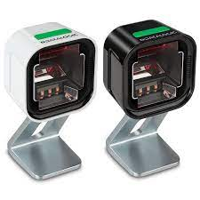
What if the scanner will not scan? It is plugged into the kiosk but will not scan.
You may have received a new scanner that needs to be configured. You will need to scan the images on the following slide in order. Once completed. Attempt to scan the IDs again to verify the scanner is functioning properly.

Slide 17
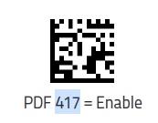
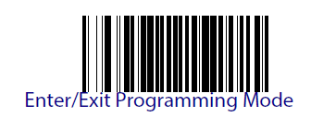
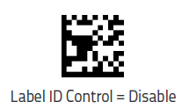
When scanning look for the barcodes
1
3
2
5
4
Yes, the “Enter/Exit Programming Mode” needs to be scanned twice.
If you have tried 4.d.i and it is still not working. Please contact your S6 or JRMS POC for additional guidance.

Slide 18
Questions

Slide 19
POC
John J. Gately
MSG, TXSG
NCOIC – T6
Texas Military Department
Office: 512-782-3383
Cell: 972-800-9160
johnny.gately@txsg.state.tx.us < Caution-mailto:johnny.gately@txsg.state.tx.us >
Texas Military Department:Platform Administrator & EIRAC
Website:Caution-https://tmd.texas.gov < Caution-https://tmd.texas.gov >
TMD App: Android & iOS
TMDTV: Roku & Amzon Fire

