Slide 1
Joint Experience by Self Nomination
J1
Notes:
Welcome to the Joint Experience by Self Nomination How to.
If you are an officer who’s had a joint assignment and you are planning to submit a Self-Nomination, then this short brief is designed for you.

Slide 2
Where do you start?
Review your Joint Officer History (JOH) by going to the Joint Qualification System Website: https://jqs.dmdc.osd.mil/appj/jqs (Note: Once you login SELECT the ELIGIBILITY CRITERIA link near the bottom).
Ensure your JPME level is up-to-date in your JOH
Review the JOM Public site for all the guides and references you will need: https://tmd.texas.gov/jom
Use the word document template to work on your questionnaire.
J1
Notes:
So where do you start?
Fist, we encourage each of you to review your joint officer history by going to the JQS website.
Ensure your record reflects the level of JPME you have completed.
Review the JOM Public site for all the guides and references you will need:
Use the word document template to work on your questionnaire.

Slide 3
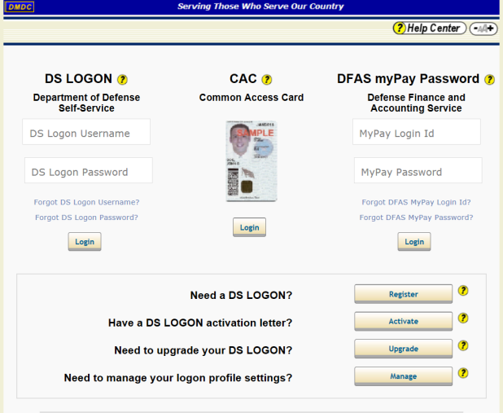
Here is the link to JQS: https://jqs.dmdc.osd.mil/appj/jqs
Initial Screen…
You will need your CAC Card to continue into the site
Notes:
This is the link you will need to follow. Make sure you have a cac enabled computer to log in. You do not have to be in a military network. A public network will work just fine.

Slide 4
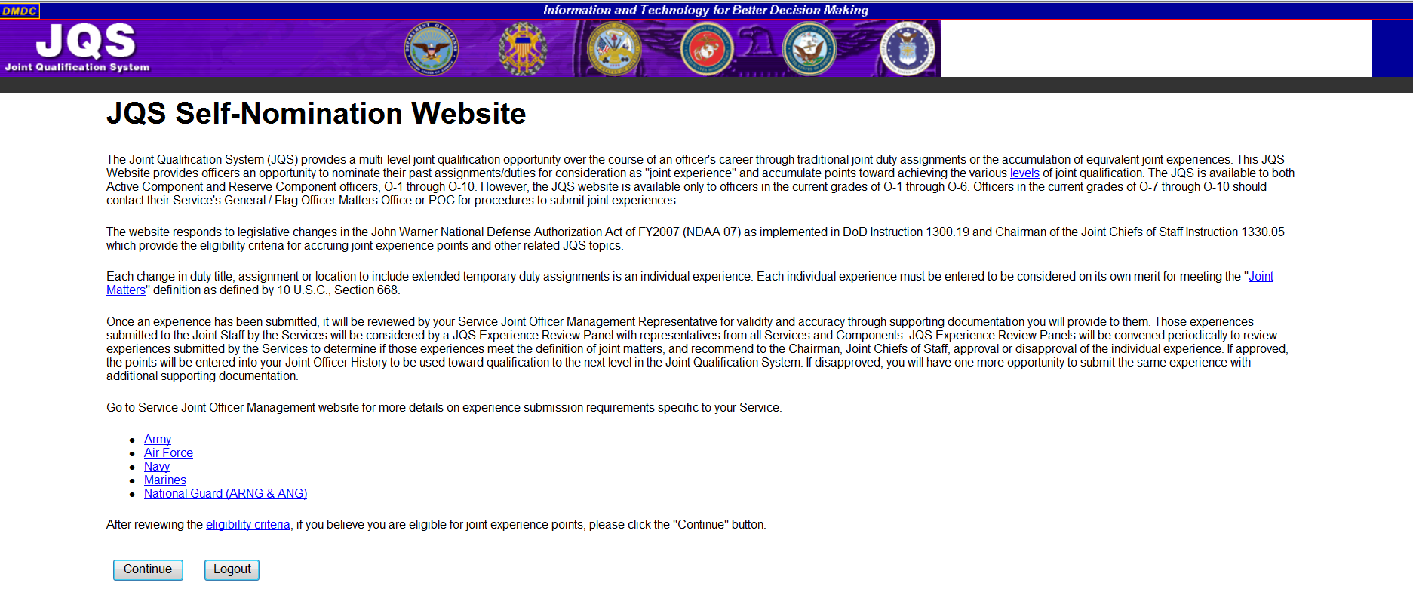
Next Screen…
X
J1
Notes:
Once you get through the initial screen, you have arrived to the Joint Qualification system site.
Do not select the hyperlinks in blue
Always select “eligibility criteria” prior to continuing with your application.
2. If you select the “National Guard (ARNG & ANG) link, you will receive an error message.
Select continue

Slide 5
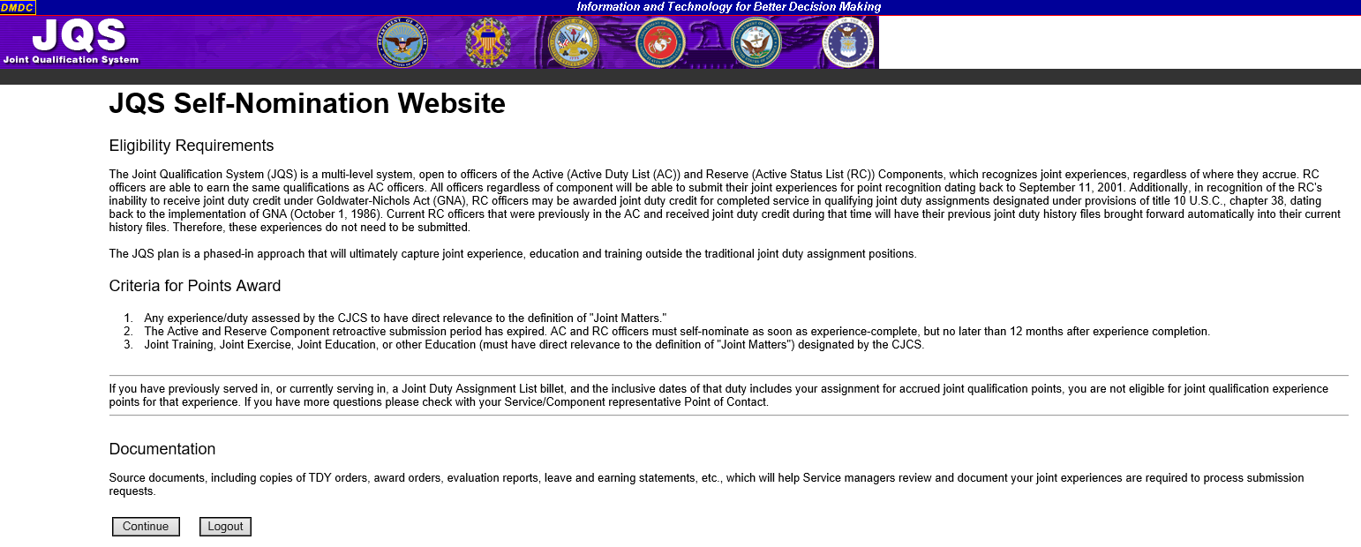
Next Screen…
J1
Notes:
Make sure you read through the eligibility Requirements and the criteria to make sure the entry you are making meets the requirements, then click continue.

Slide 6
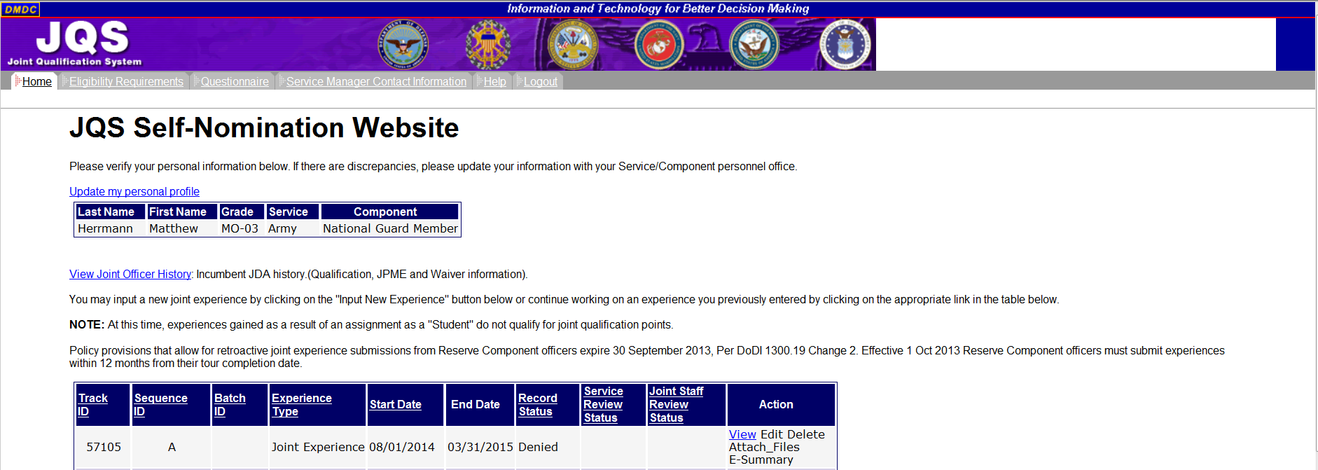
Next Screen…
1.
2.
3.
J1
Notes:
If this is the first time visiting the site, you will need to update your personal profile. Select the link and fill in the information. Once complete, select the submit icon and it will return you to this screen.
You will also have the ability to view your Joint Officer History. By selecting the “View Joint Officer History” link, you can view your S-JDA Position History, E-JDA Joint Experiences, Discretionary Points, and Joint Education.
Once you submit a self-nomination packet, you can view, edit, delete, or add files/documentation. Additionally, in the event your packet is approved or disapproved, you can view the E-Summary from the packet. You can view all your previous submissions on this screen.

Slide 7
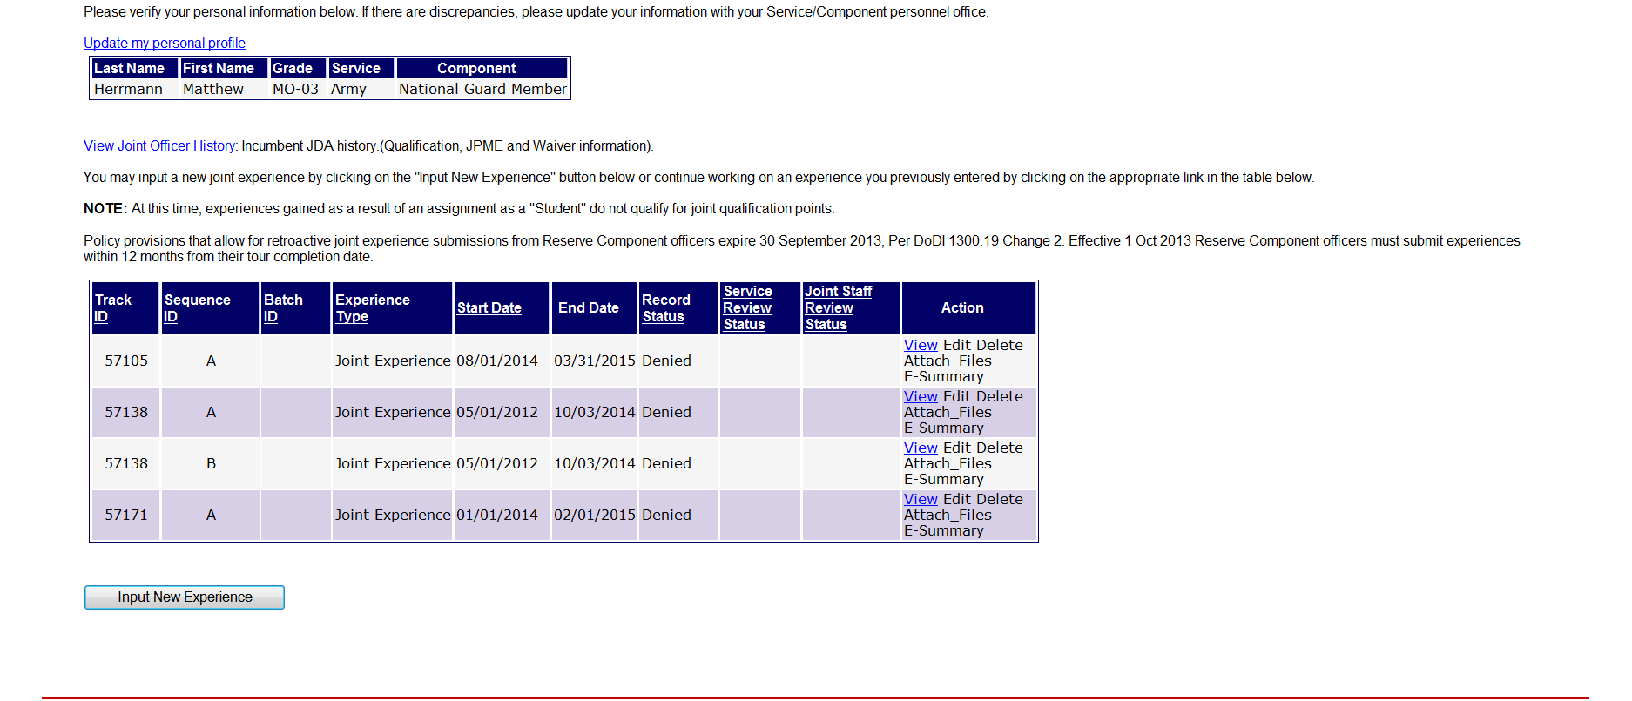
Next Screen…
Notes:
At the bottom of this screen, you will see the link for submitting a new experience. Selecting this link will initiate the self-nomination application process.

Slide 8
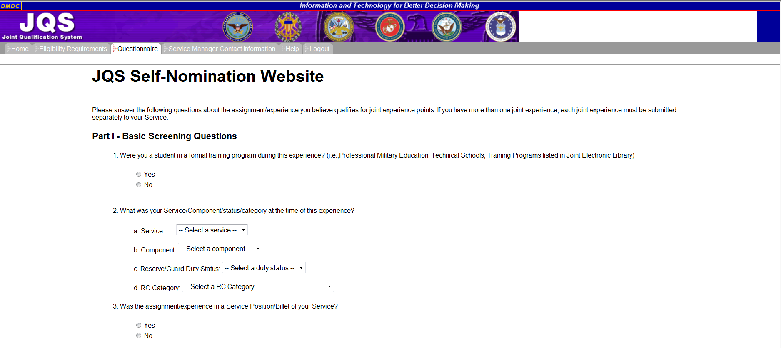
Next Screen…
J1
Notes:
At any time during the application process, you can select one of the tabs at the top of the screen.
Questions in this section are straightforward. As a Guardsman, Army or Air, you will select the appropriate responses from the drop down menus.

Slide 9
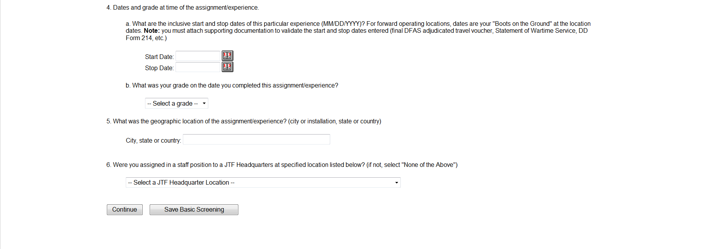
Next Screen…
J1
Notes:
When entering your Start/Stop dates, it is important they match the dates found in your attached supporting documentation, e.g., orders, DD 214, etc. An OER (Army) or OPR (Air Force) DOES NOT count as a validating document for start/stop date information.
2. For Question 6, unless your JTF HQ is listed in the drop down menu, you will select “None of the Above” (the last selection on the menu).
3. Once you have completed Questions 1-6, select “Continue”. If you select “Save Basic Screening,” you will be redirected to your Personal Profile page, with the latest entry added to your tracker. You can return to your packet at any time by accessing JQS.

Slide 10
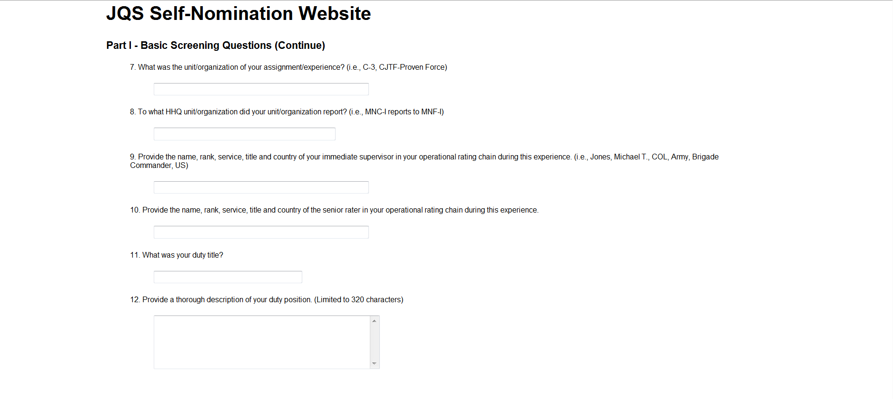
Next Screen…
J1
Notes:
It is important to answer each question as thoroughly as possible. Do not leave any questions blank.
For Question 12, ensure your duty description meets the 320 character limit. If it is over the 320 character limit, it will only capture the first 320 characters in your Joint Experience Summary. Note: A space will count as a character.

Slide 11
Next Screen…
J1
Notes:
1. It is important to answer each of these questions, if possible and if applicable. If not applicable, answer with N/A

Slide 12
Next Screen…
J1
Notes:
Part III is the most important portion of your Self-Nomination packet. Based on your responses for whichever of the six categories are selected, the E-JDA Board will decide to Approve, Disapprove, or Return your packet for rework.
2. Each of your responses (for those that apply to your experience) must meet the definition of “Joint Matters” to be considered for approval.
3. Responses cannot exceed a 340 character (including spaces) count. If you go over the 340 character limit, you will not be able to submit your packet.

Slide 13
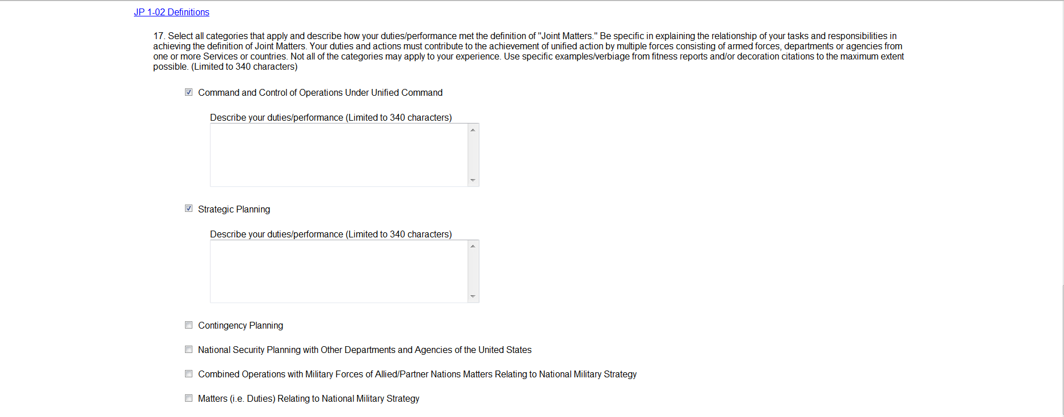
Next Screen…
J1
Notes:
When a category is selected, a box will appear for you to submit your description. For completing Question 17, you only need one category for submission, however, you may select as many or as few categories as they apply to your duties. It should be noted, when reviewing self-nomination packets, the E-JDA Board tends to favor packets with a minimum of five categories. While you only need one category to submit, it is critical to have as many as possible.
If you exceed the 340 character limit, the system will not allow you to proceed with your application. This is why we recommend you work your self nomination application via the word document on the TMD JOM Public site. This way you will have ample time to choose the right verbiage to articulate your joint experience accurately. Then once you are ready to fill your application, all you need to do is copy and paste.

Slide 14
Next Screen…
J1
Notes:
Once you answer Questions 18 & 19, REVIEW your submission to ensure you have answered all questions to the best of your ability, leaving no answer blank. (If unable to provide an answer, respond with N/A.)
When your application is complete, select “Submit to Service POC.” If you do not want to submit, you can select “Save All” which returns you to the packet tracker page, with your most recent submission listed.

Slide 15
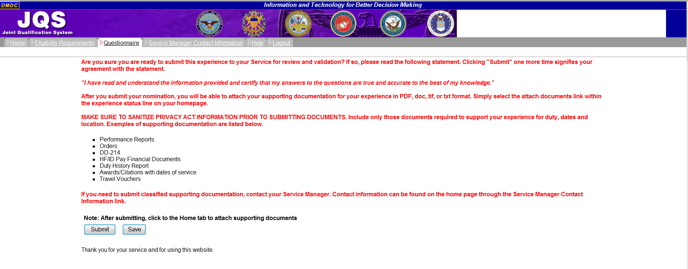
Next Screen…
J1
Notes:
Once you have read the information in red type, select the “Submit” link.
Ensure you have all your necessary supporting documentation available for upload.

Slide 16
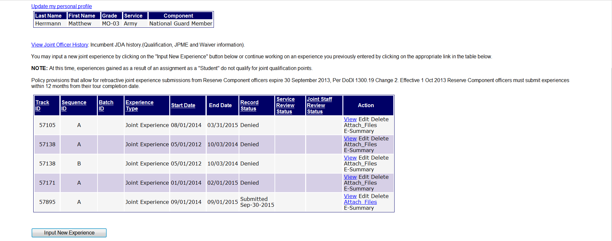
Next Screen…
J1
Notes:
After selecting the “Submit” link, you will be redirected to your tracker page, with your most recent application saved in JQS.
Your packet status will be listed under the Record Status column.
You will have the opportunity to attach your supporting documentation by selecting “Attach Files” in the Action column.

Slide 17
What’s next?
- Once your packet has been submitted to the batching queue, it will remain there until the batch closes (two-three weeks prior to the E-JDA Board proceedings).
- At any point prior to the batch closing, the packet can be removed from the queue and returned to the officer in the event modifications are required.
- If modifications need to be made to your category details, the service manager can assist. However, in order to change any of the information (Questions 1-16), the packet will need to be returned to the officer for rework.
J1
Notes:
Congratulations! If you followed these steps, then you have submitted your self-nomination!
Your self nomination will remain in a batching queue until the batch closes. It will be extracted two-to-three weeks prior to the EJDA Board proceedings.
Keep in mind that at any time the application can be removed from the queue if the NGB JOM representative recommends modifications
If modifications are needed the request is sent directly to you for re-work.

Slide 18
If Re-work is required….
- If your packet is marked as “Back for Rework”, you will receive an E-mail message indicating you have 90 days to resubmit the packet or it will expire.
- In JQS, under your packet tracker, your packet will appear as “Rework” under the Record Status column. You can View, Edit, or Delete the packet from this page.
- If you decide to Edit, simply follow the same process for an initial packet submission.
- Once you have reworked your packet, and resubmitted, it will re-appear in the pre-batch queue.
J1
Notes:
Read the slide

Slide 19
Lessons Learned from JQS Review Panels
- Develop answers to your questions on a word document to provide thorough descriptions
- Multiple assignments must be submitted as separate experiences
- Understanding the Joint Matters Definition
- Service in billets such as aide or executive assistant service is normally a negative discriminator
J1
Notes:
Lessons learned,
The hardest part of answering the questionnaire is writing your duty description to 320 characters and answering the remaining questions under 340 characters. That is why we recommend you write your template on a word document and once you feel confident that everything is covered, you may email it to J1 JOM email distro for a quick review prior to submitting the application in the JQS. Also, keep in mind that if you need more room, you may submit a memorandum for record as an attachment to help telling your story of your joint experience.
Officers must ensure Multiple assignments must be submitted as separate experiences.
Dates are validated and duties are verified as meeting the definition of Joint Matters using the following supporting documentation:
o Letter of Evaluation (AF Form 77)
o Decorations/Awards with citations/narratives
o Officer Performance Report (OPR)
o Travel vouchers (the final travel voucher that shows what you were paid)
o Memorandum for Records
Understanding the Joint Matters Definition is a common issue. A good understanding of the definition of Joint Matters is paramount before proceeding to the next step. Your J1 JOM representative can answer any questions regarding the definition
Service in billets such as aide or executive assistant service is normally a negative discriminator. If you are an army aid working for an Air Force general, it does not mean that you are

Slide 20
References:
DoDI 1300.19 Joint Officer Management Program Procedures, 2018
AF Joint Officer Management Handbook, 2014
NGB Joint Qualification Handbook, 2011
J1
Notes:
Here are the references you can use to do more research.
The two hand books have really good information for guidelines of submissions.
The Air Force management hand book provides examples of approved and disapproved submissions you can review.

Slide 21
Visit our website: https://tmd.texas.gov/jom
or
Contact us with your questions!
ng.tx.txarng.mbx.jom@mail.mil
JOINT MATTERS!
J1
Notes:
Thank you for listening to this presentation, If you have questions or want to learn more please visit our website. As always, J1 is here to help!

