Slide 1
Commander’s Call
August 2016
Lt Col Travis “TD” Walters

Slide 2
Our Agenda
Recognition
Commander’s Intent
MXS/CC Monthly Priorities
Weekend Highlights
Mentorship Minute
Vector Check/Looking Ahead
A Parting Thought

Slide 3
PROMOTIONS
Congratulations!
SSgt Seth Holderby
SSgt Scott Teague
TSgt Paul McCool
TSgt Martha Pierce

Slide 4
12 OAY/Sijan Award
Lance P. Sijan Leadership Award
SMSgt Efren Perez (Senior Enlisted)
TSgt Edwin Robbins (Junior Enlisted)
Outstanding Airman of the Year
MSgt Daniel Ralston (SNCO)
TSgt William Darnell (NCO)
SrA Francheska Wulf (AMN)

Slide 5
NEW HIRES
AGE Supervisor – MSgt Bill Guernsey
Specialist Pro Super – MSgt Matt Stiles
MXS First Sergeant – TSgt Neil Robertson
Under Shirts – TSgts Orona/McCool
In the Works – MXS/CC, E-9 EMB Chief,
E-8 Fabrication Superintendent

Slide 6
Commander’s Intent
“The 136th Maintenance Squadron will execute on order … the production and projection of effective combat power and domestic support … anywhere, anytime and for any user … as deemed necessary by the appropriate chain of command. The efforts of this Squadron … to the person … will focus upon and center around this very intent.”

Slide 7
So Ask Yourself Daily…
Am I Ready?
Are the Herks Ready?

Slide 9
MXS/CC Priorities: August
New Commander Transition
October Exercise
Pending Personnel Actions

Slide 10
MXS/CC Priorities: September
MXS Change of Command
Chief Chavers Retirement
October Exercise

Slide 11
Weekend Highlights
SATURDAY
0730-0745 MXG/CC Call Fuel Cell
0805-0815 FOD Walk Flightline
1000-1030 LMR Training Wing MPR
1300-1400 Interviewing 101 Wing MPR
1300-1500 Shelter Manager/PAR Team 1671A,B Classroom
1530-1700 Capt Goodwin Retirement MXS Classroom
SUNDAY
0730-0800 MXS/CC Call MXS Classroom
0800-0830 Chapel Wing MPR
0900-1000 Enlisted Advisory Council LRS Conference Room

Slide 12
Mentorship Minute
WELL DONE MXS: Jan 2015 – Sep 2016
Successful AEF & Air Advisor deployments
First 8-ship max fly since 1991
Cut MXS fitness failure rate by over 60%
Dramatically increased MXS communications
Next generation assumed leadership
Renewed focus on professionalism
Extra emphasis on Airman recognition
First AFOUA in 24 years

Slide 13
Vector Check
DD Form 2875s and AF Form 4394s need to be updated; if not complete by Sept, network account will be disabled
Certify/process all AROWS/DTS products for remainder of FY (now-30 Sep) immediately
EPRs: TSgt Close Out – 30 November
SECAF/CSAF reduced additional duties guidance
Children’s Mock Deployment – 10 September

Slide 14
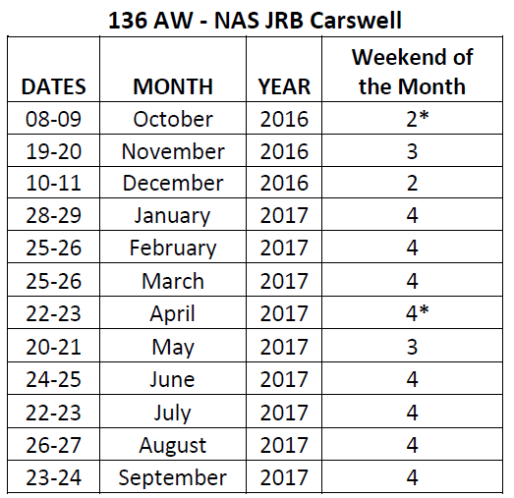
Looking Ahead
24-25 September UTA
CMSgt Chavers Retirement
MXS Change of Command
2016 WREX
8-15 Oct: fly away ORE to Gulfport CRTC
Drill is 8-9 October: plan ahead for being on orders

Slide 15
A Parting Thought
Thank you

Slide 16
TEXAS AIR NATIONAL GUARD

